Slide 1

STARDUST
Terra Collapse Deep Dive
Theresa Garcia (Theresa@stardustfunds.com)
Adit Patel (adit.patel@stardustfunds.com)

Slide 2
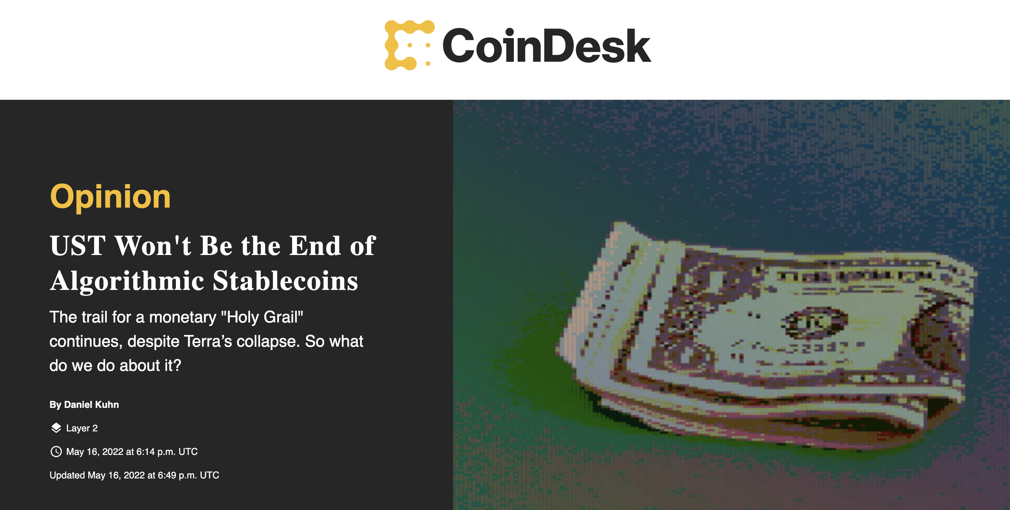
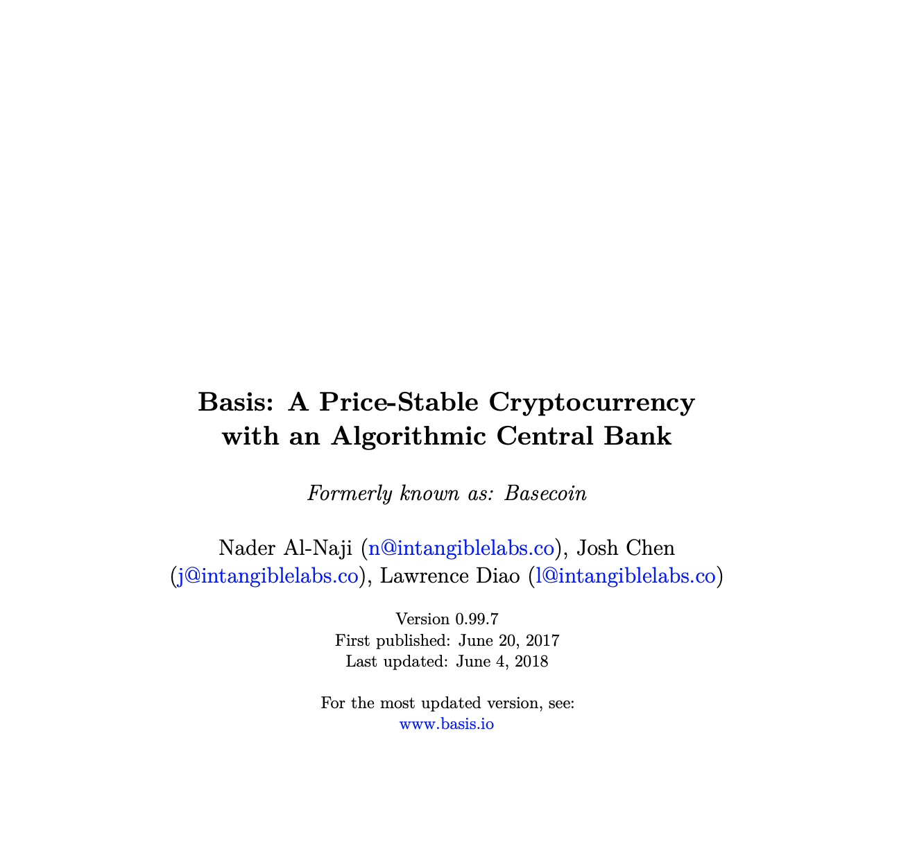
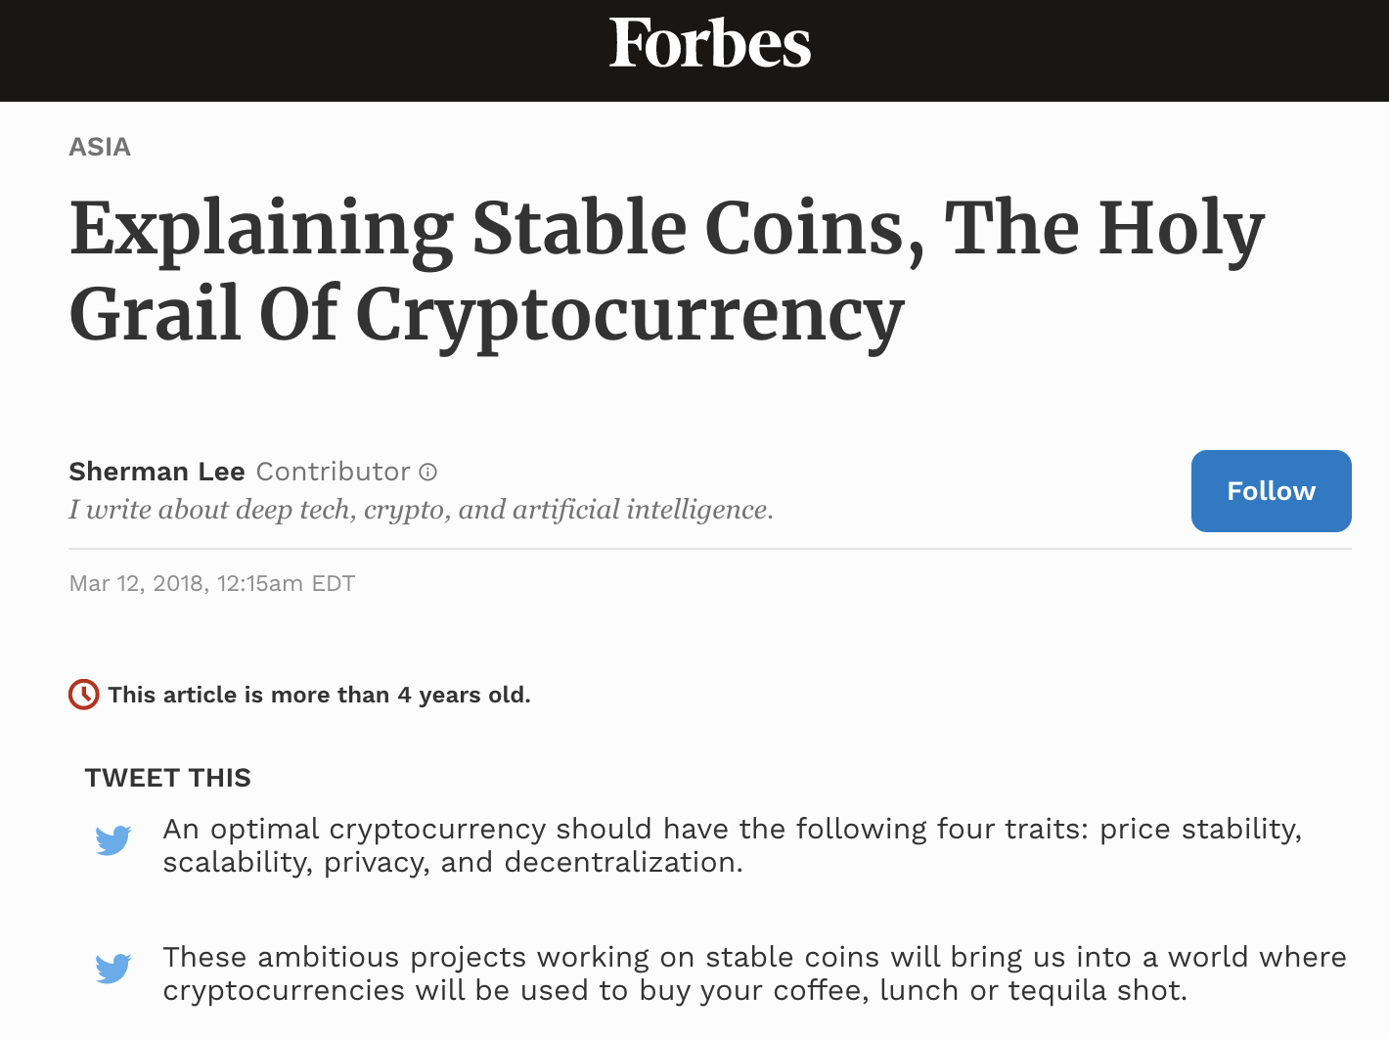

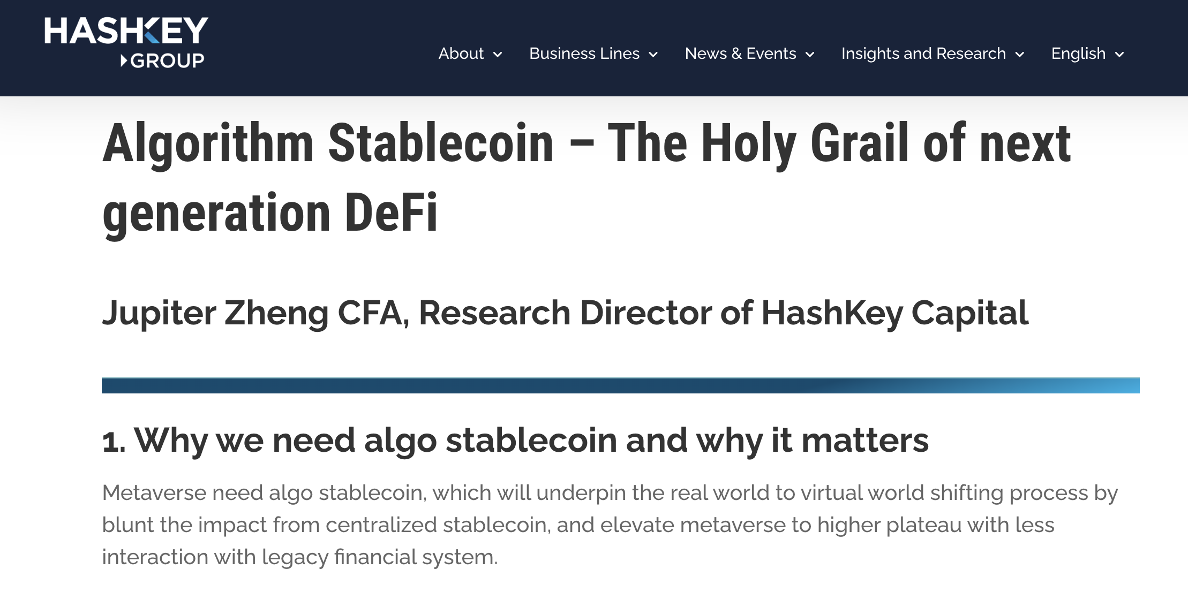
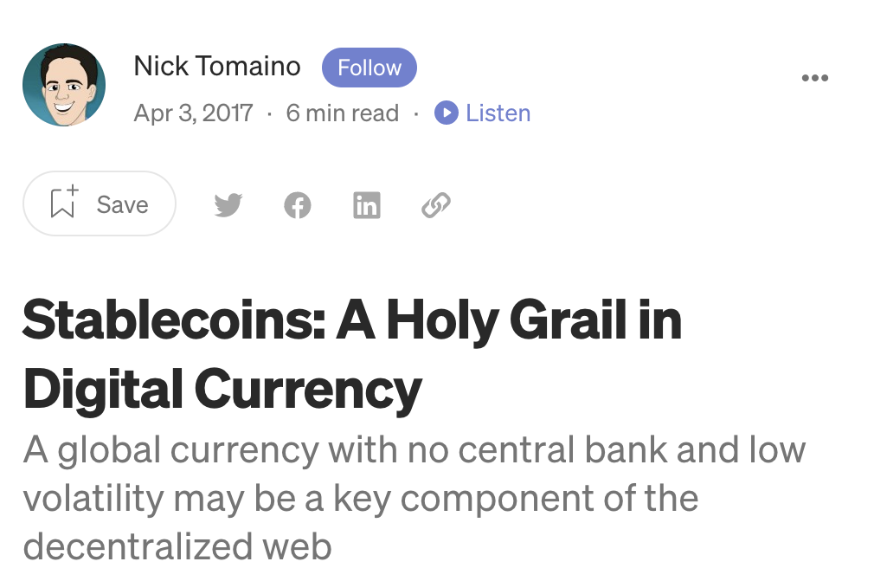

An uncollateralized stablecoin is considered one of the holy grails of crypto. In 2018, a company called Basis tried to create one of the first.
An uncollateralized algorithmically managed stablecoin is
considered by many to be the holy grail of crypto.
Basis (formerly Basecoin) was one of the very first attempts.
Notes:
https://www.coindesk.com/layer2/2022/05/16/ust-wont-be-the-end-of-algorithmic-stablecoins/
https://www.forbes.com/sites/shermanlee/2018/03/12/explaining-stable-coins-the-holy-grail-of-crytpocurrency/?sh=4a69d8424fc6
https://www.hashkey.com/algorithm-stablecoin-the-holy-grail-of-next-generation-defi/
https://cmp.smu.edu.sg/article/stablecoins-cryptocurrency-holy-grail
https://thecontrol.co/stablecoins-a-holy-grail-in-digital-currency-b64f3371e111
https://www.basis.io/basis_whitepaper_en.pdf

Slide 3
All algorithmic stablecoins, regardless of architecture, attempt to control token supply to match demand to ensure a consistent peg to a reference currency.
When Demand increases (1), the algorithm mints tokens and injects them into the market increasing Supply (2).
When Demand contracts (1), the algorithm burns tokens and removes oversupply from the market (2).
Demand
Supply
Demand
Supply
(1)
(2)
(1)
(2)
Pegged Price
Pegged Price
Here demand for the stablecoin has increased, illustrated as movement (1). Naturally, this would tend to increase prices, however the algorithm instead increases the overall token supply, illustrated as movement (2). This is trivial to execute as tokens can simply be printed and deployed through open market operations on DEXs and other exchanges.
Here overall demand for the stablecoin has decreased, illustrated as movement (1). Naturally, this would tend to decrease prices. In order to maintain the pegged price, the algorithm decreases the overall token supply, illustrated as movement (2). This is significantly more difficult to execute as the tokens are in the market and are not easily accessed for destruction.

Slide 4
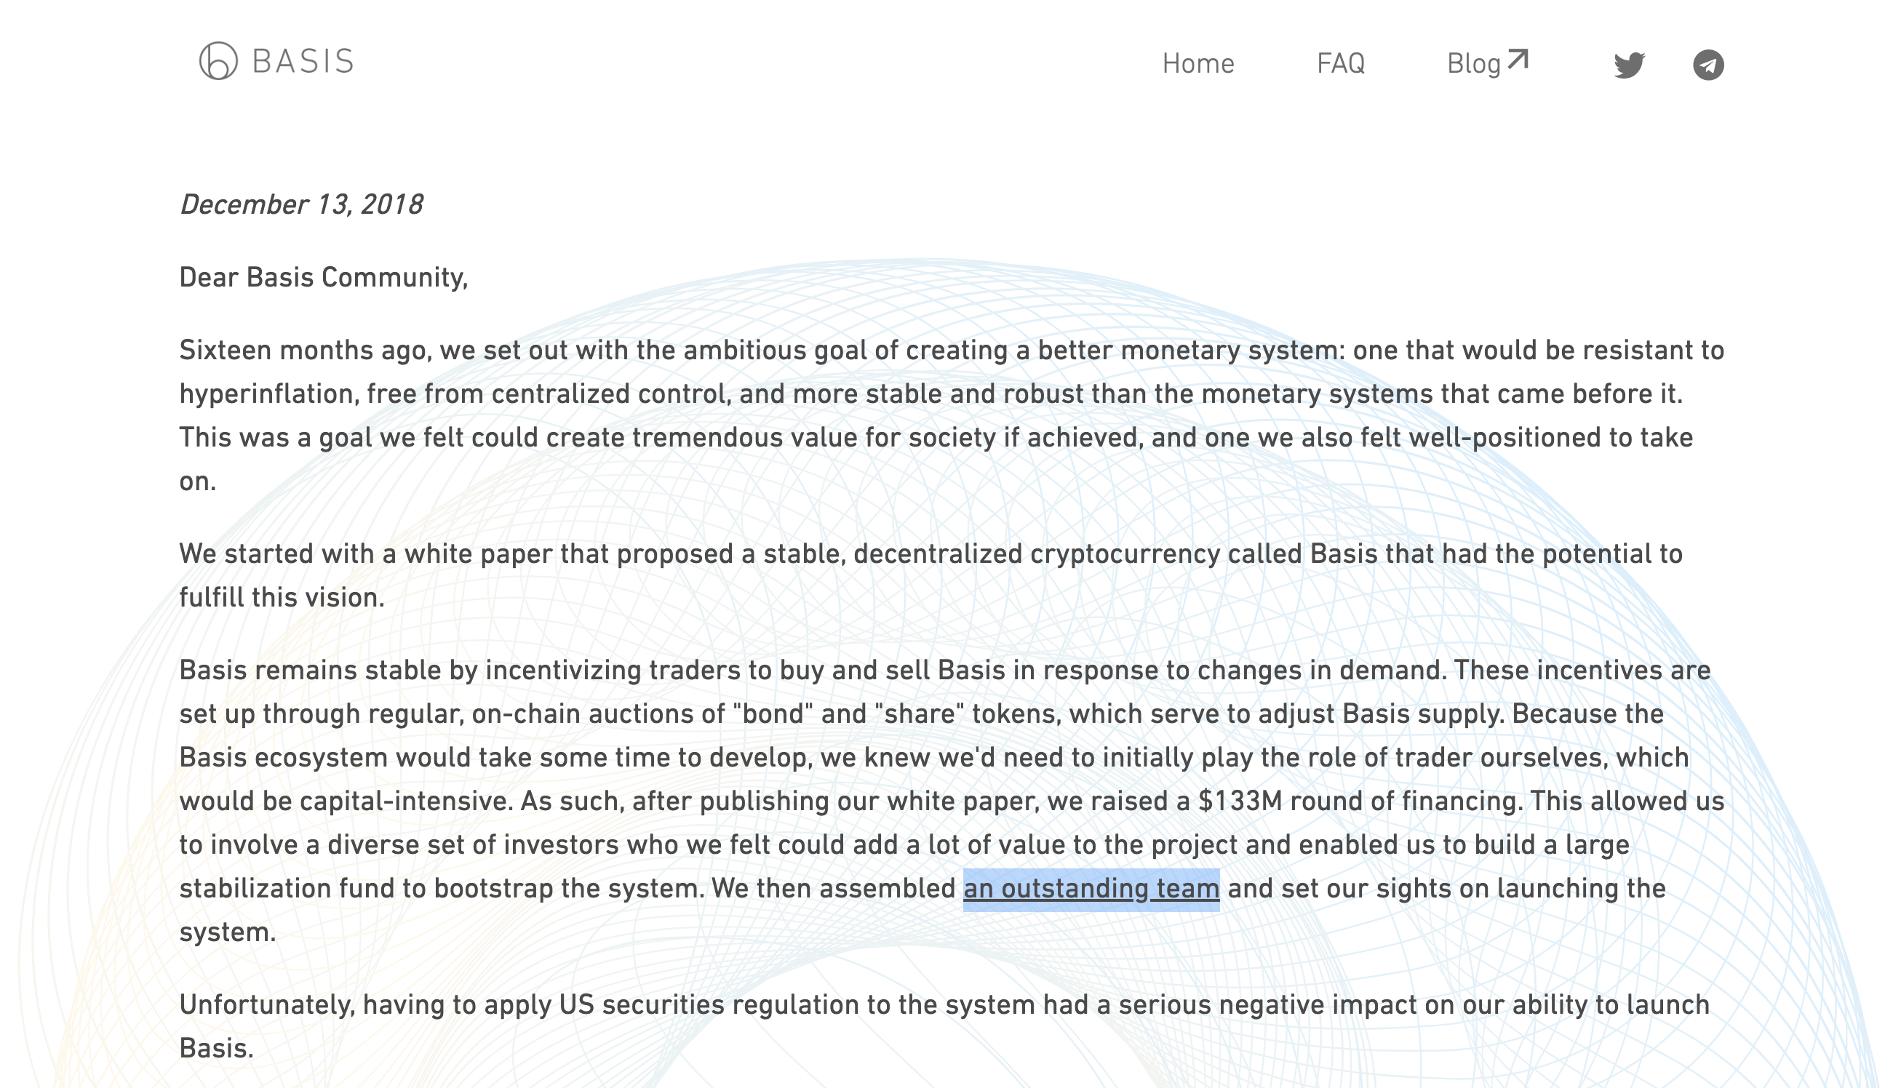
Basis planned to institute a stablecoin model superficially based on the principles of central banking, however in late 2018, the project was unable to launch due to US securities regulation.
Basis bonds, the means by which they would buy back tokens to control supply, were considered a security by the SEC.
Notes:
https://www.basis.io/

Slide 5
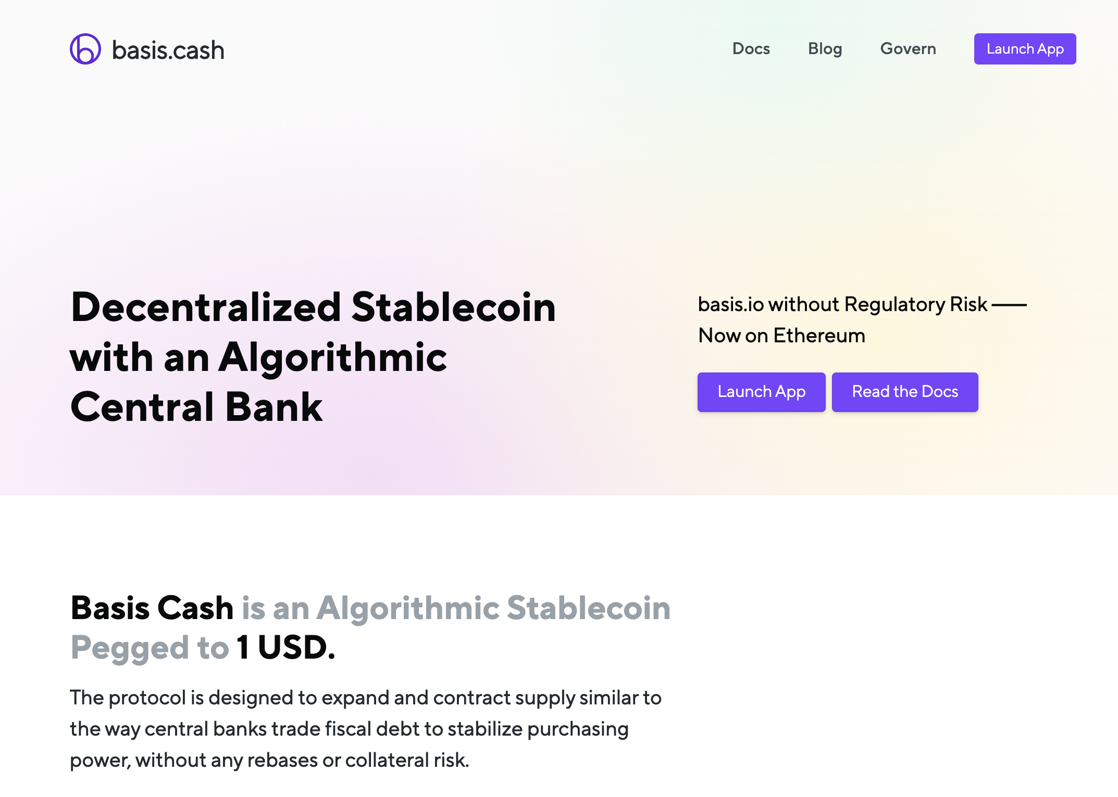
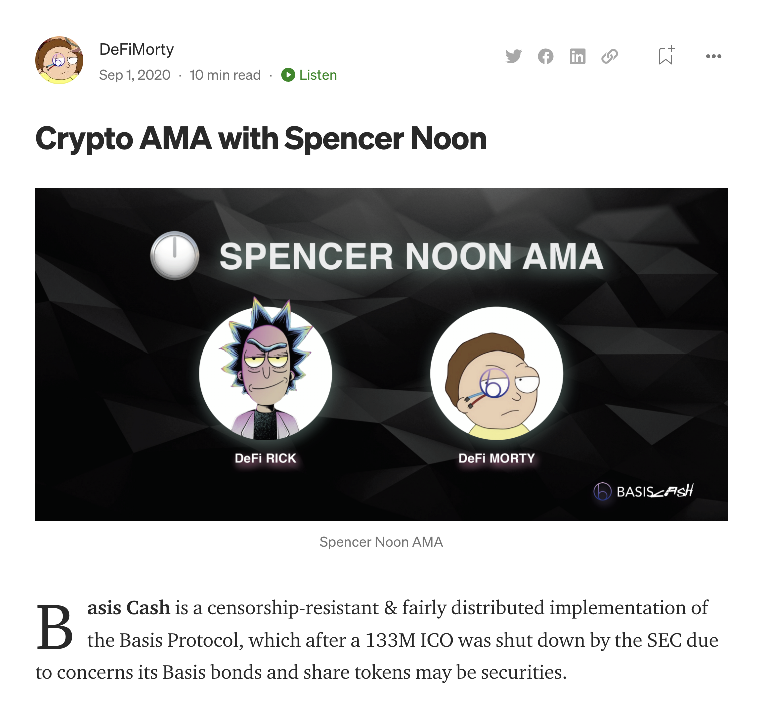
Despite the shutdown of the original Basis.io project, two anonymous developers, “Rick” and “Morty”, built and launched Basis Cash (BAC) based on the original thesis.
Basis.cash attempted to anonymously develop and deploy a stablecoin based on the architecture invented by Basis.io
The two primary developers nicknamed themselves
“DeFi RICK” and “DeFi MORTY”
Notes:
https://basis.cash/
https://medium.com/basis-cash/crypto-ama-with-spencer-noon-c61ef8ecb55

Slide 6
Basis Cash failed almost immediately after launch, the stabilization mechanism was completely unable to manage the peg even for a short period of time.
Basis Cash (BAC) was completely unable to maintain the peg to the USD.
Notes:
https://www.coingecko.com/
https://finance.yahoo.com/quote/BAC-USD/

Slide 7
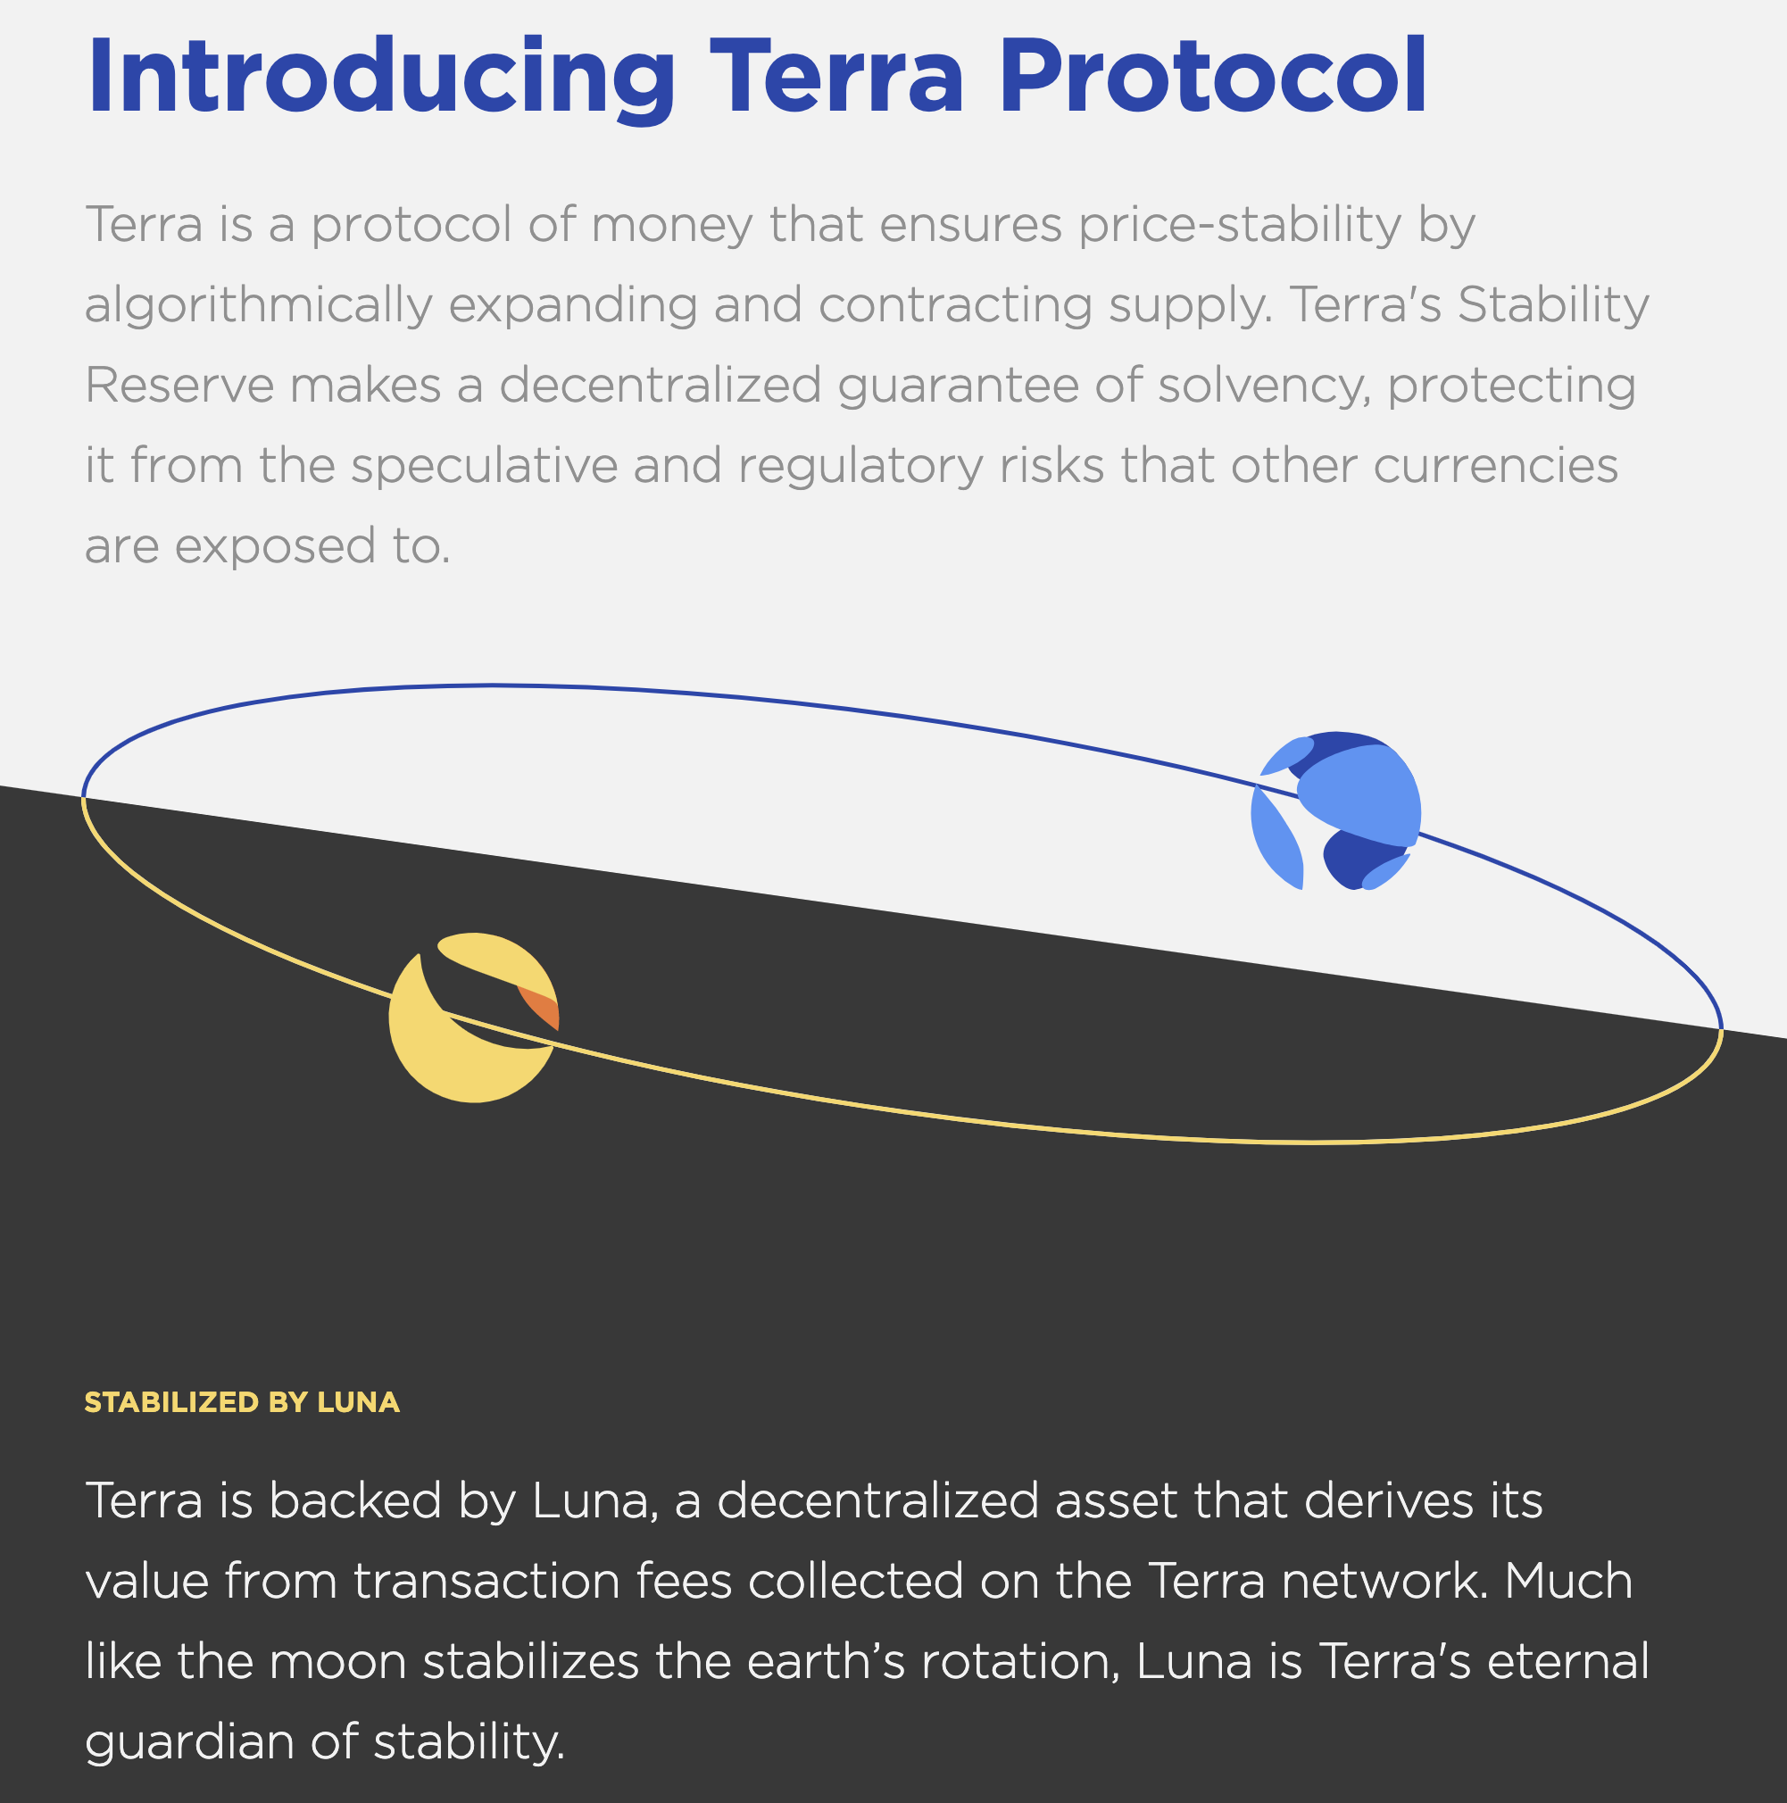
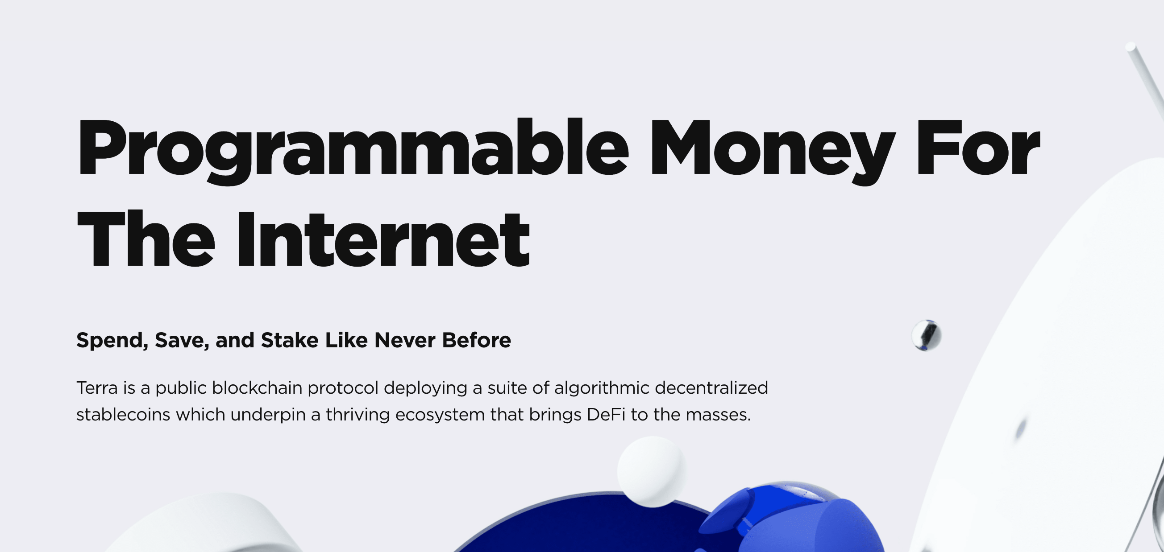
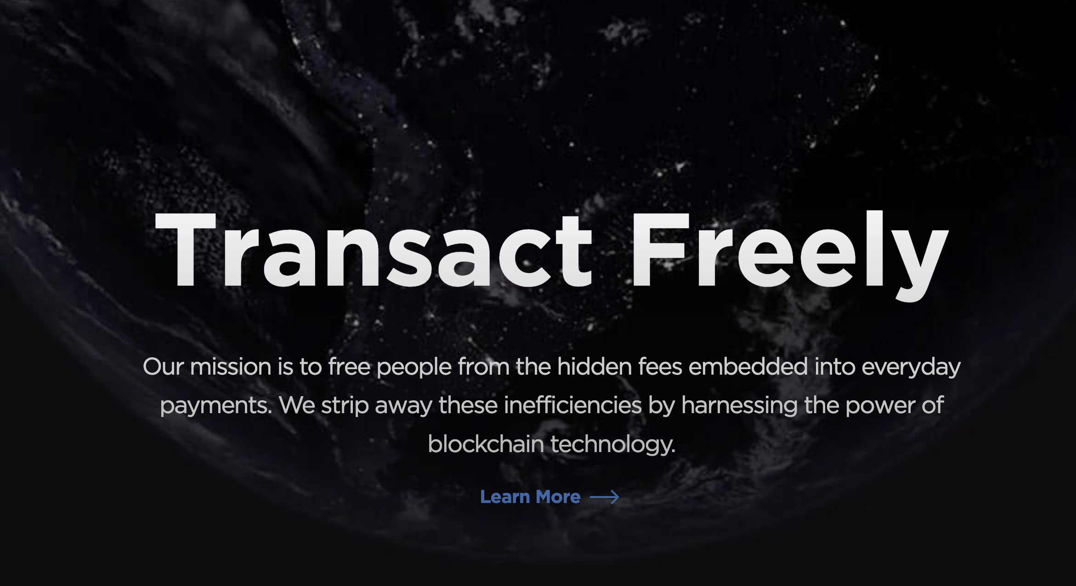
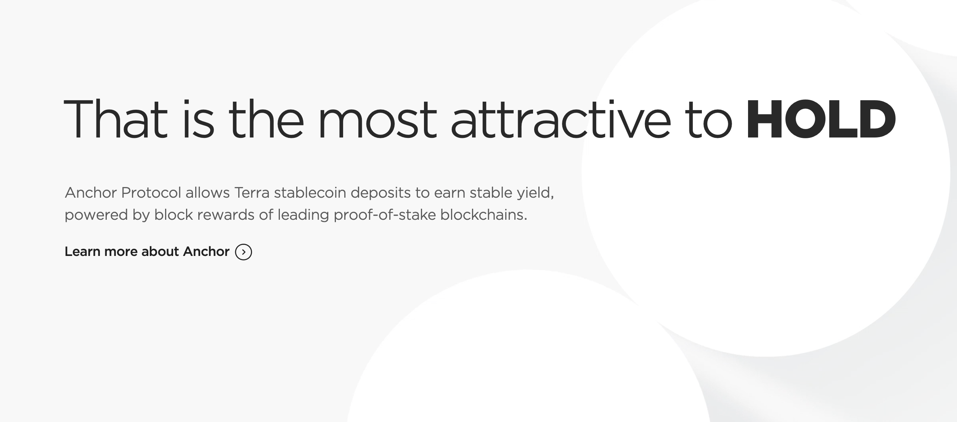

Unbeknownst to most, “DeFi RICK” was Do Kwon, a co-founder of Terraform Labs (TFL). TFL’s original strategy was to streamline digital payments in Do Kwon’s native home, South Korea.
Terra was originally intended to streamline payments before pivoting to DeFi.
Focus on Payments in the Early Years (2018-2020)
Terra originally was intended to be a payments platform. In order to remedy the currency risks that vendors would be exposed to if they transacted in highly volatile cryptocurrencies, Terra developed a stablecoin backed by transaction fees.
DeFi Focused after late 2020
The transaction platform Chai never saw widespread adoption so Terraform labs appears to have pivoted its strategy to focus heavily on Decentralized Finance applications, particularly securities (Mirror) and lending (Anchor Protocol).
Notes:
https://web.archive.org/web/*/terra.money

Slide 8






In order to facilitate real world payments, Terra had a built-in stablecoin, known as TerraUSD (UST). It belongs to the class of multi-token algorithmically managed stablecoins.
Stability Mechanism
Summary
Undersupply of Shares
Currency Risk Is Theoretically Segregated:
The logic behind this model is that the store of value stablecoin, ex. Terra, is now insulated from demand/supply shocks which will theoretically be absorbed by the bond token price, ex. Luna.
Assumes Demand for The Underlying Bond Token:
While there is no collateral for either token, Terra is unique in that Luna is the native token of Terra’s layer 1 blockchain and is necessary to pay gas fees on the network.
Very Susceptible to Hyperinflation:
In an extreme example, IRON, a stablecoin developed by Iron Finance implemented a version of this model with their second token TITAN. As they are both simple ERC-20 tokens, there is no inherent utility and as such lacked a base demand level. When a few of the largest TITAN holders liquidated a portion of their holdings, it snowballed into a run on the token. Without intrinsic demand, the currency quickly loses its ability to maintain its price, further destabilizing in a runaway effect. Titan today trades at $0.0000001461 USD from its high of $61.23. This effect is analogous to runaway hyperinflation in traditional banking markets. Recently Neutrino, one of the largest stablecoins has slipped from its peg for similar reasons.
During periods of undersupply, bond token holders, ex. Luna, are incentivized to burn their tokens to mint the stablecoin, ex. Terra (UST).
“Bond” Token
(Volatile)
“Shares” Token
(Stablecoin)
TITAN
Luna
Terra
IRON
Waves
Oversupply of Shares
Neutrino
During periods of oversupply, stablecoin holders, ex. Terra (UST), are incentivized to burn their stablecoins to mint the bond token, ex. Luna
These tokens, along with other stablecoin architectures are summarized in our state of the industry report. We’ll go over the high level features and challenges in this presentation.
Notes:
Stardust State of Industry Report:
https://stardust.finance/resources/StateofStablecoins.pdf

Slide 9
While originally intended to serve as a payments platform, the payment platform, Chai, never really took off. Growth plateaued in late 2020 and payment volumes were quickly shrinking.
Payment volume was declining and Chai as a payments platform showed little promise.
For additional context, just credit card transactions are in excess of ₩800 Trillion a year, meaning Chai volume is less than 0.2% of South Korean credit card transactions alone and shrinking.
Notes:
https://app.flipsidecrypto.com/velocity/queries/65819a71-8548-4149-86f4-691e6ba860bf
https://www.statista.com/statistics/650812/south-korea-credit-cards-transaction-value/

Slide 10
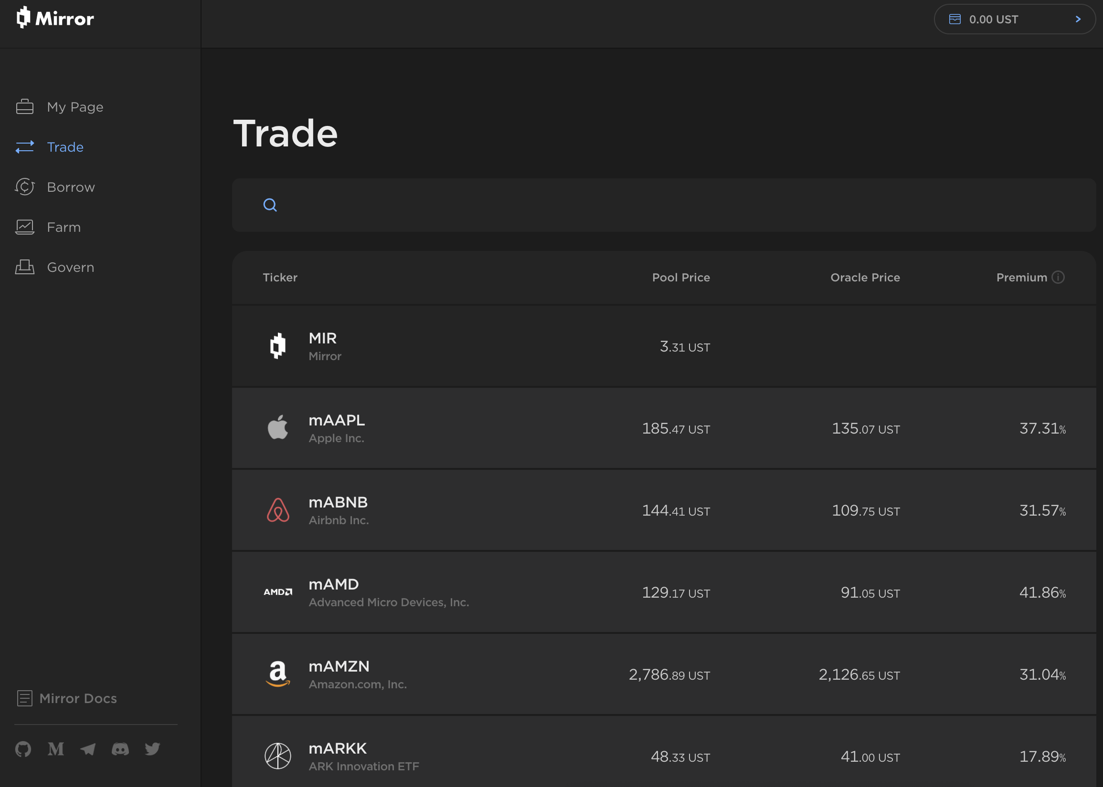
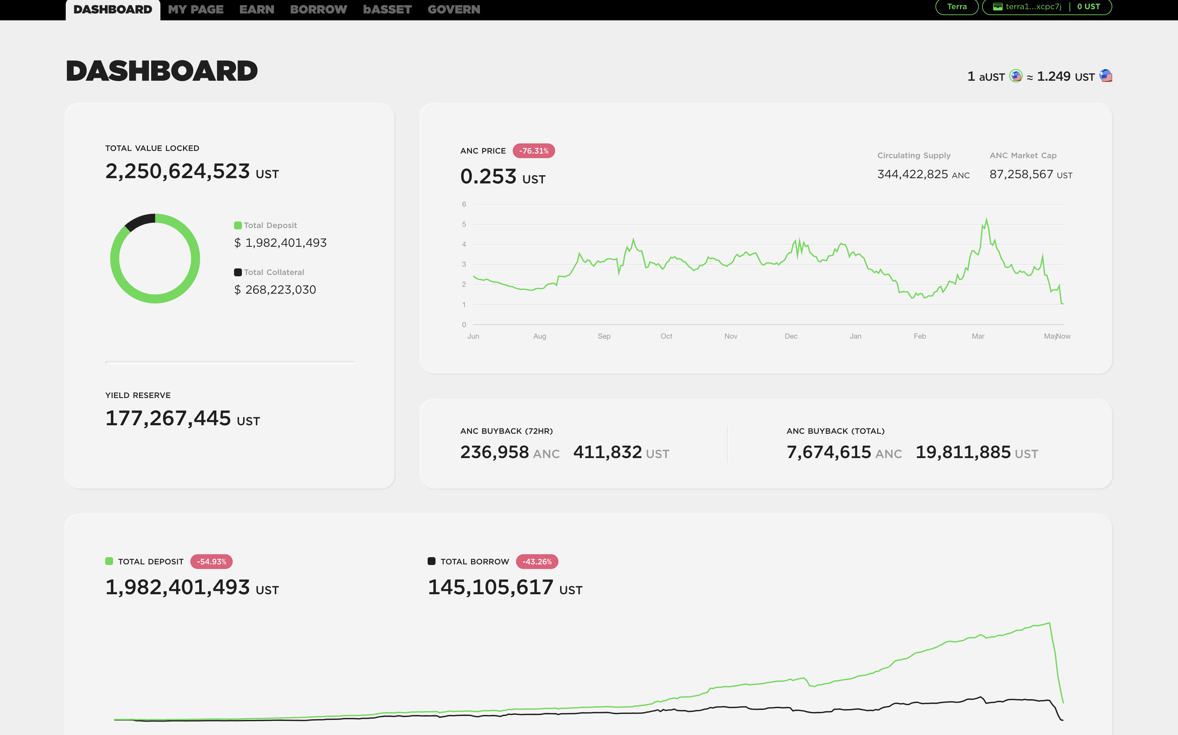
Terraform Labs switched strategies from a focus on payments to a focus on DeFi and internally developed two platforms to add utility for their stablecoin, Anchor and Mirror.
These two projects were intended to shift Terra’s main utility away from payments to the new world of DeFi.
Mirror Protocol
Mirror Protocol was designed to mimic Synthetix on the Ethereum blockchain. It offers synthetic securities, essentially allowing users to mint tokens that serve as proxies for real world securities.
Anchor Protocol
Anchor served as the lending protocol and was by a wide margin the more successful of the two. With a headline figure of 20% interest on a stablecoin, it made yield farming simple and attracted billions of dollars to the platform.
Notes:
https://mirrorprotocol.app/#/trade
https://app.anchorprotocol.com/

Slide 11
While both created demand for billions of UST, Anchor was by far the killer app of the Terra network with nearly 75% of all UST locked on the platform.
Mirror saw early adoption but wasn’t able to sustain its growth.
Anchor meanwhile continued to grow strongly off the back of its 20% interest rate.
Mirror never saw widespread adoption. A large part of that was the legal and regulatory challenges it faced in the United States. After peaking in mid-2021 at a paltry $2B in TVL, it quickly shrank through the rest of the year.
Anchor meanwhile was an overnight success. Its 20% APR attracted billions of dollars of capital to the platform and would regularly double its Total Value Locked (TVL) on a monthly basis, growing to nearly $18B in less than 1 year.
Notes:
https://defillama.com/protocol/mirror
https://defillama.com/protocol/anchor

Slide 12
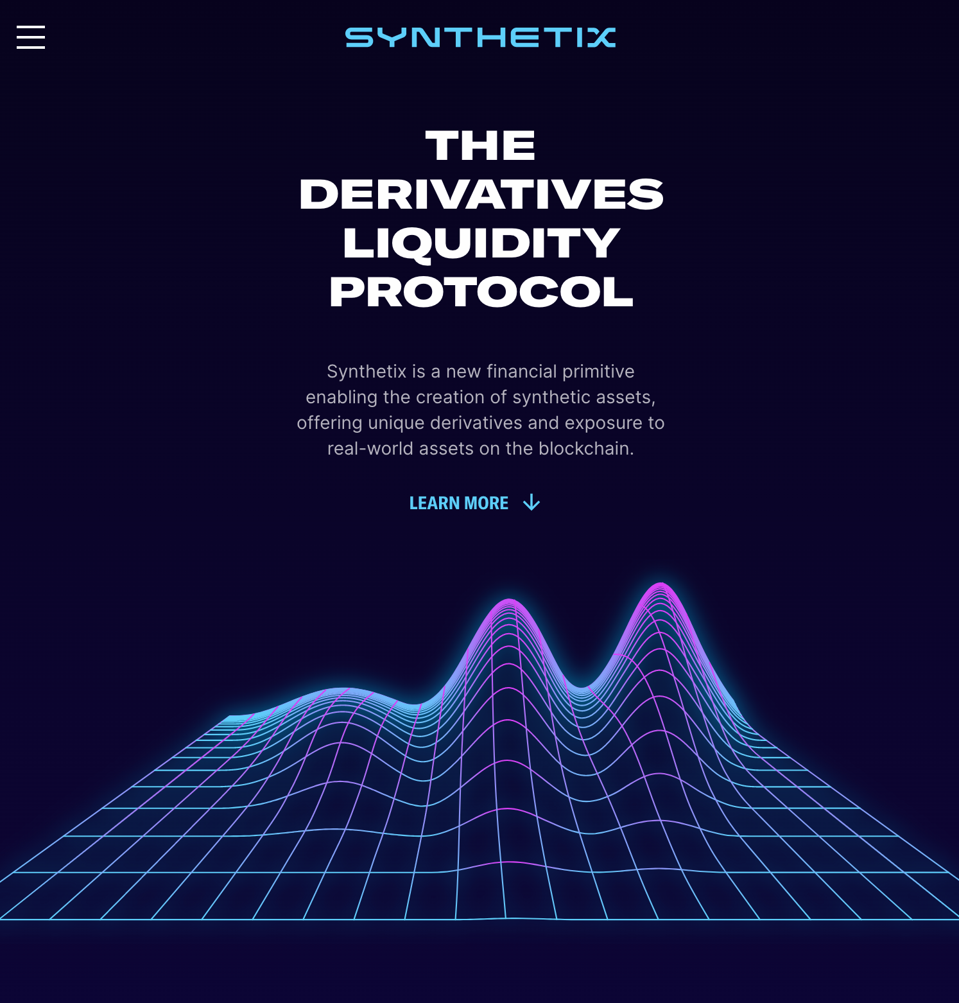
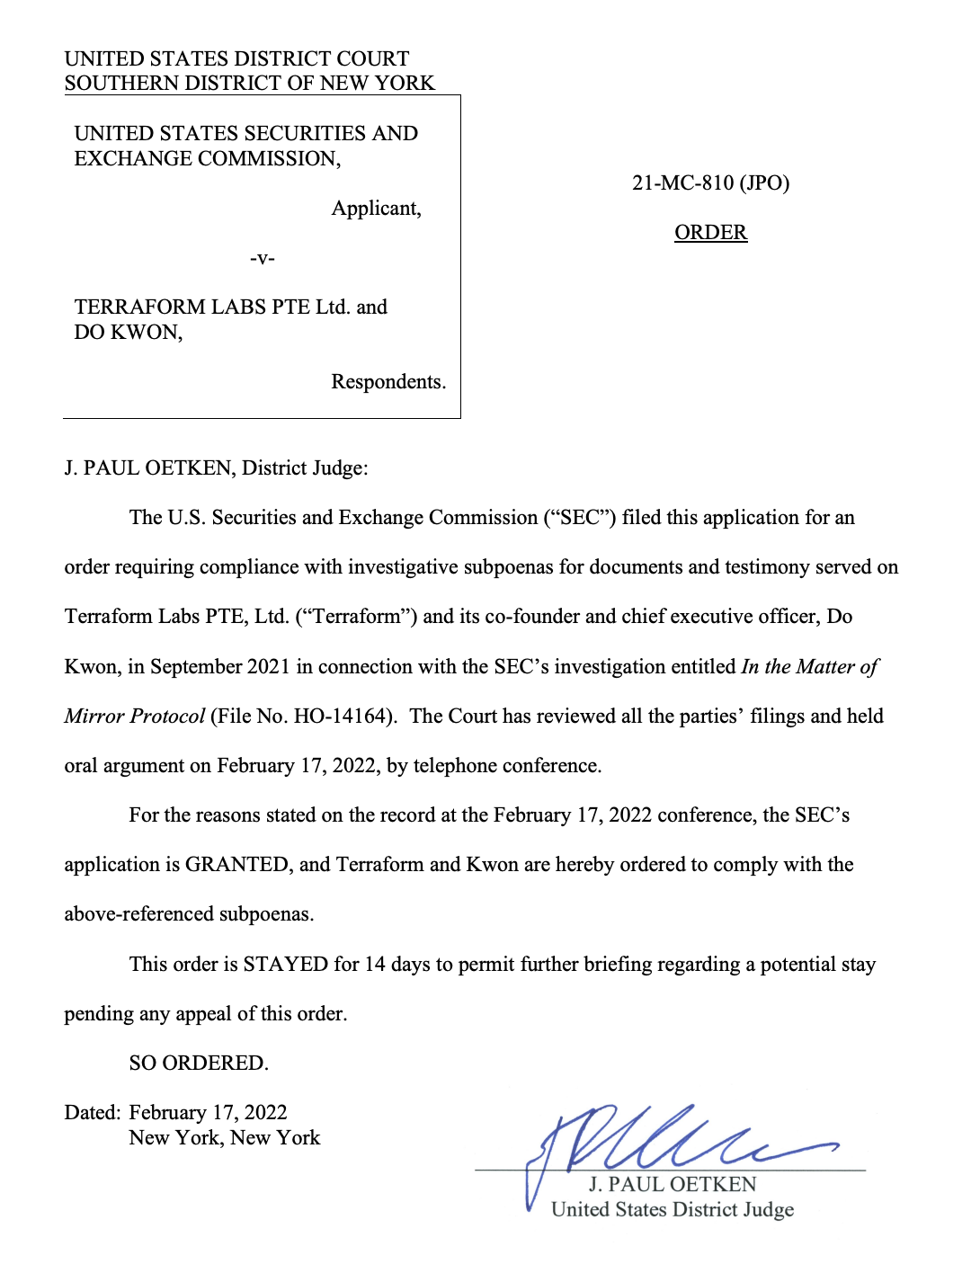
Mirror experienced challenges almost immediately, within 5 months of launch it was subpoenaed by the SEC for potential violation of federal securities laws.
Mirror is very similar to the original synthetic derivative protocol on the Ethereum mainnet, Synthetix
As services like these can be construed as “securities” Terraform Labs was quickly subpoenaed by the SEC.
Notes:
https://synthetix.io/
https://www.sec.gov/litigation/litreleases/2021/lr25262.htm
https://storage.courtlistener.com/recap/gov.uscourts.nysd.569722/gov.uscourts.nysd.569722.28.0_1.pdf

Slide 13
Luckily for Terraform Labs, the market’s craving for Anchor was insatiable and it generated more than $10B of UST demand in less than 12 months, spiking the value of Luna.
Stablecoins by Market Cap and Type (Measured on January 1st 2022)
Notes:
https://defillama.com/protocol/anchor
https://finance.yahoo.com/quote/LUNA1-USD/

Slide 14
This demand for Anchor fell even quicker, leading to the complete collapse of Terra. Over the next few slides we’ll breakdown the events and dynamics that lead to its demise.
Summary of Events
5/7/2022 4:00 UTC
Large consistent outflows from Anchor begin, over the next 48 hours nearly $3B of capital leave Anchor.
5/9/2022 21:20 UTC
28,205 BTC are sent
from LFG to Binance.
5/10/2022 2:20 UTC
Binance suspends trading
of UST below 0.70.
5/9/22 - 5/13/22
BTC liquidation is unable to offset the rapid collapse in demand. In just 4 days, 95% of all Anchor deposits had left the platform. Outflows from Anchor alone exceeded 10B UST in just 48 hours.
5/10/22 - Present
Without LFG reserves both Terra and Luna enter a freefall. As Terra holders mint LUNA, it increases the supply more than 19,000x causing the network to shut down for a period of time and collapsing the price of LUNA.
5/4/2022 18:00 UTC
US Federal Reserve announces rate hikes to 0.9% beginning May 5th.
This immediately impacts the broader equities markets and Luna. This depression spreads to BTC, ETH and the broader crypto markets.
5/9/2022 14:36 UTC
42,530 BTC are sent from LFG reserves to Gemini.
5/10/2022 7:00 UTC
LFG BTC temporarily
stabilizes prices.
5/7/2022 17:00 UTC
LFG begins to drain liquidity out of the Curve3+UST Pool in preparation for the move to 4Pool.
5/9/2022 9:00 UTC
Curve3+UST Pool now drained of liquidity, cannot accommodate normal exchange demand. Terra price begins initial depeg.
Notes:
https://www.federalreserve.gov/newsevents/pressreleases/monetary20220504a1.htm
https://dune.com/mhonkasalo/4pool-Curve-FRAXUSTUSDCUSDT
https://bitinfocharts.com/bitcoin/wallet/Luna-LFG
https://coinmarketcap.com/currencies/terrausd/
https://app.flipsidecrypto.com/velocity/queries/ffd84e80-0854-44d8-aace-2404bbdd25e9
https://app.flipsidecrypto.com/velocity/queries/106a6e5e-a4a5-4e99-b6b9-6eed226d8f00
https://jackofalltechs.com/2022/05/15/onchain-analysis-report-says-terras-bitcoin-reserves-were-sent-to-binance-and-gemini/

Slide 15
Ultimately, the loss of demand for Anchor, Terra’s key product, is the primary cause of the collapse. Capital began its sustained net outflow from Anchor on May 7th 4:00 UTC.
No specific event seems have triggered these outflows as the actual flows on-chain are from unrelated wallets withdrawing money throughout the day at randomly distributed timings. Some wallets continued to withdraw through the 13th.
5/7/2022 4:00 UTC
The net outflows started to begin around 4:00 UTC. Several unrelated wallets entered in small withdrawals and continued to enter additional withdrawals as it snowballed into $2.7B outflow by the next day.
5/10/2022 7:00 UTC
LFG reserves stemmed the outflows temporarily.
5/8/2022 1:00 UTC
At its peak, outflows reached nearly $700M in an hour from Anchor, driven here by a single transaction withdrawing $350M.
TX:64012F29AD6DA88CACFFD7ABC9B57F90AF1368B94A36C677BF55A5F94BBB6404
5/9/2022 9:00 UTC
Once Terra began to depeg, it inspired an even more aggressive sustained outflow from Anchor that ultimately emptied 90% of the invested capital over the course of just 6 days. These are enormous outflows that moved nearly 13B tokens of UST, nominally worth $13B USD.
Notes:
https://app.flipsidecrypto.com/velocity/queries/ffd84e80-0854-44d8-aace-2404bbdd25e9
https://app.flipsidecrypto.com/velocity/queries/106a6e5e-a4a5-4e99-b6b9-6eed226d8f00

Slide 16
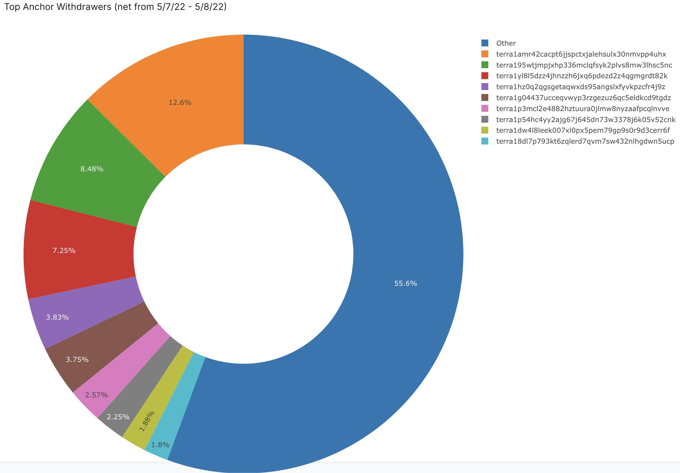
There are circulating rumors that these outflows were an attack. While not conclusive, the evidence doesn’t seem to indicate any malicious activity or even intent.
This wallet, responsible for the $350M outflow on the 7th, appears to be an automatic bot making regular purchases.
The withdrawing wallets seem to be disjointed and random, with the majority of volume coming from small wallets.
This wallet regularly deposited into Anchor, cashed out all the generated interest, and made a separate withdrawal transaction everyday for months, leading us to believe it is a wallet for a smart contract or third party investing service. In addition, it made a large withdrawal on the 7th but still left sizable holdings in Anchor which it only withdrew after the price for UST had collapsed, an indicator that it wasn’t an intentional or even purposeful attack.
@pedroexplore1 on twitter had identified the outflows the day of and highlighted their disjointed nature. 55.6% of total volume was coming from smaller wallets. While the wallet mentioned on the left of this slide was responsible for 12.6% of volume, it doesn’t seem to be pre-meditated or even intentional. It seems it’s a bot batching orders and there was simply a market demand for net withdrawals in light of market volatility the previous day.
Notes:
https://finder.terra.money/mainnet/address/terra1amr42cacpt6jjspctxjalehsulx30nmvpp4uhx
https://twitter.com/pedroexplore1/status/1523410936819642369

Slide 17
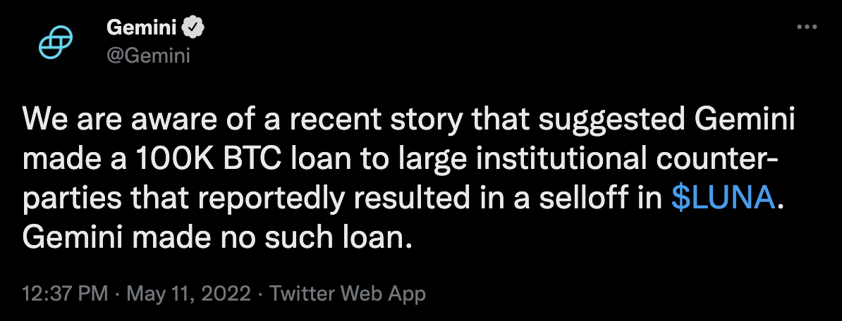
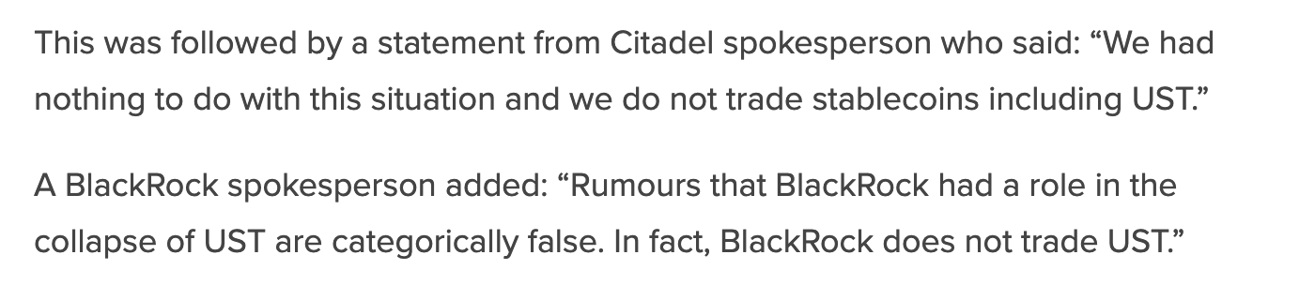
The rumors, originating on unmoderated forums and Twitter, specifically mention Gemini, Citadel and Blackrock. However, each has issued an official release denying any involvement.
Blackrock, Gemini, and other’s have officially responded and with denials, and the incentives don’t align.
Official Denials
Incongruent Incentives
While their denials can reasonably be doubted, the incentives don’t align.
Implausibly Large Capital Loans:
The original thread indicated that an individual or firm borrowed 100K BTC ($4.6B) to execute this attack. That is a sizable amount of capital as Gemini only had $30B in custody in 2021 across all crypto assets. 100K BTC might be the majority of their BTC holding.
Difficult to Coordinate and Possibly Unprofitable Firm Wide:
For an attack to be successful, the hedge fund needs to coordinate an attack while ensuring it has suspended all other long strategies. These strategies are then deployed back into the market after a successful attack, something we haven’t observed on-chain.
Unpredictable Contagion:
Even if a hedge fund of that size could coordinate an attack, collapsing a $60B ecosystem would introduce unpredictable contagion possibly to their counterparties and possibly their own positions.
Attracting Significant Regulatory Scrutiny:
The collapse of Terra has already attracted interest from Janet Yellen and other large regulators. It is highly unlikely that an hedge fund would seek to attract that sort of regulatory scrutiny in the current market environment in the US where both parties are seeking to restrict Wall Street activities.
Blanket Official Denials:
Every accused company has publicly gone on record to deny and refute every activity they were rumored to have done. Gemini has stated they have not made any Bitcoin Loans and Black Rock and Citadel both deny participating in any attack.
Non-Credible Sources:
The ultimate source of these rumors seems to be speculation on 4Chan, an unmoderated anonymous English-language imageboard website. Most outlets with substantive credibility have at best not reported on these claims with most outright refuting them. It was amplified by Cardano’s founder on twitter before being subsequently deleted.
Notes:
https://boards.4channel.org/biz/thread/48625257
https://news.bitcoin.com/blackrock-citadel-gemini-deny-involvement-in-terra-collapse/
https://www.gemini.com/blog/gemini-crypto-under-custody

Slide 18
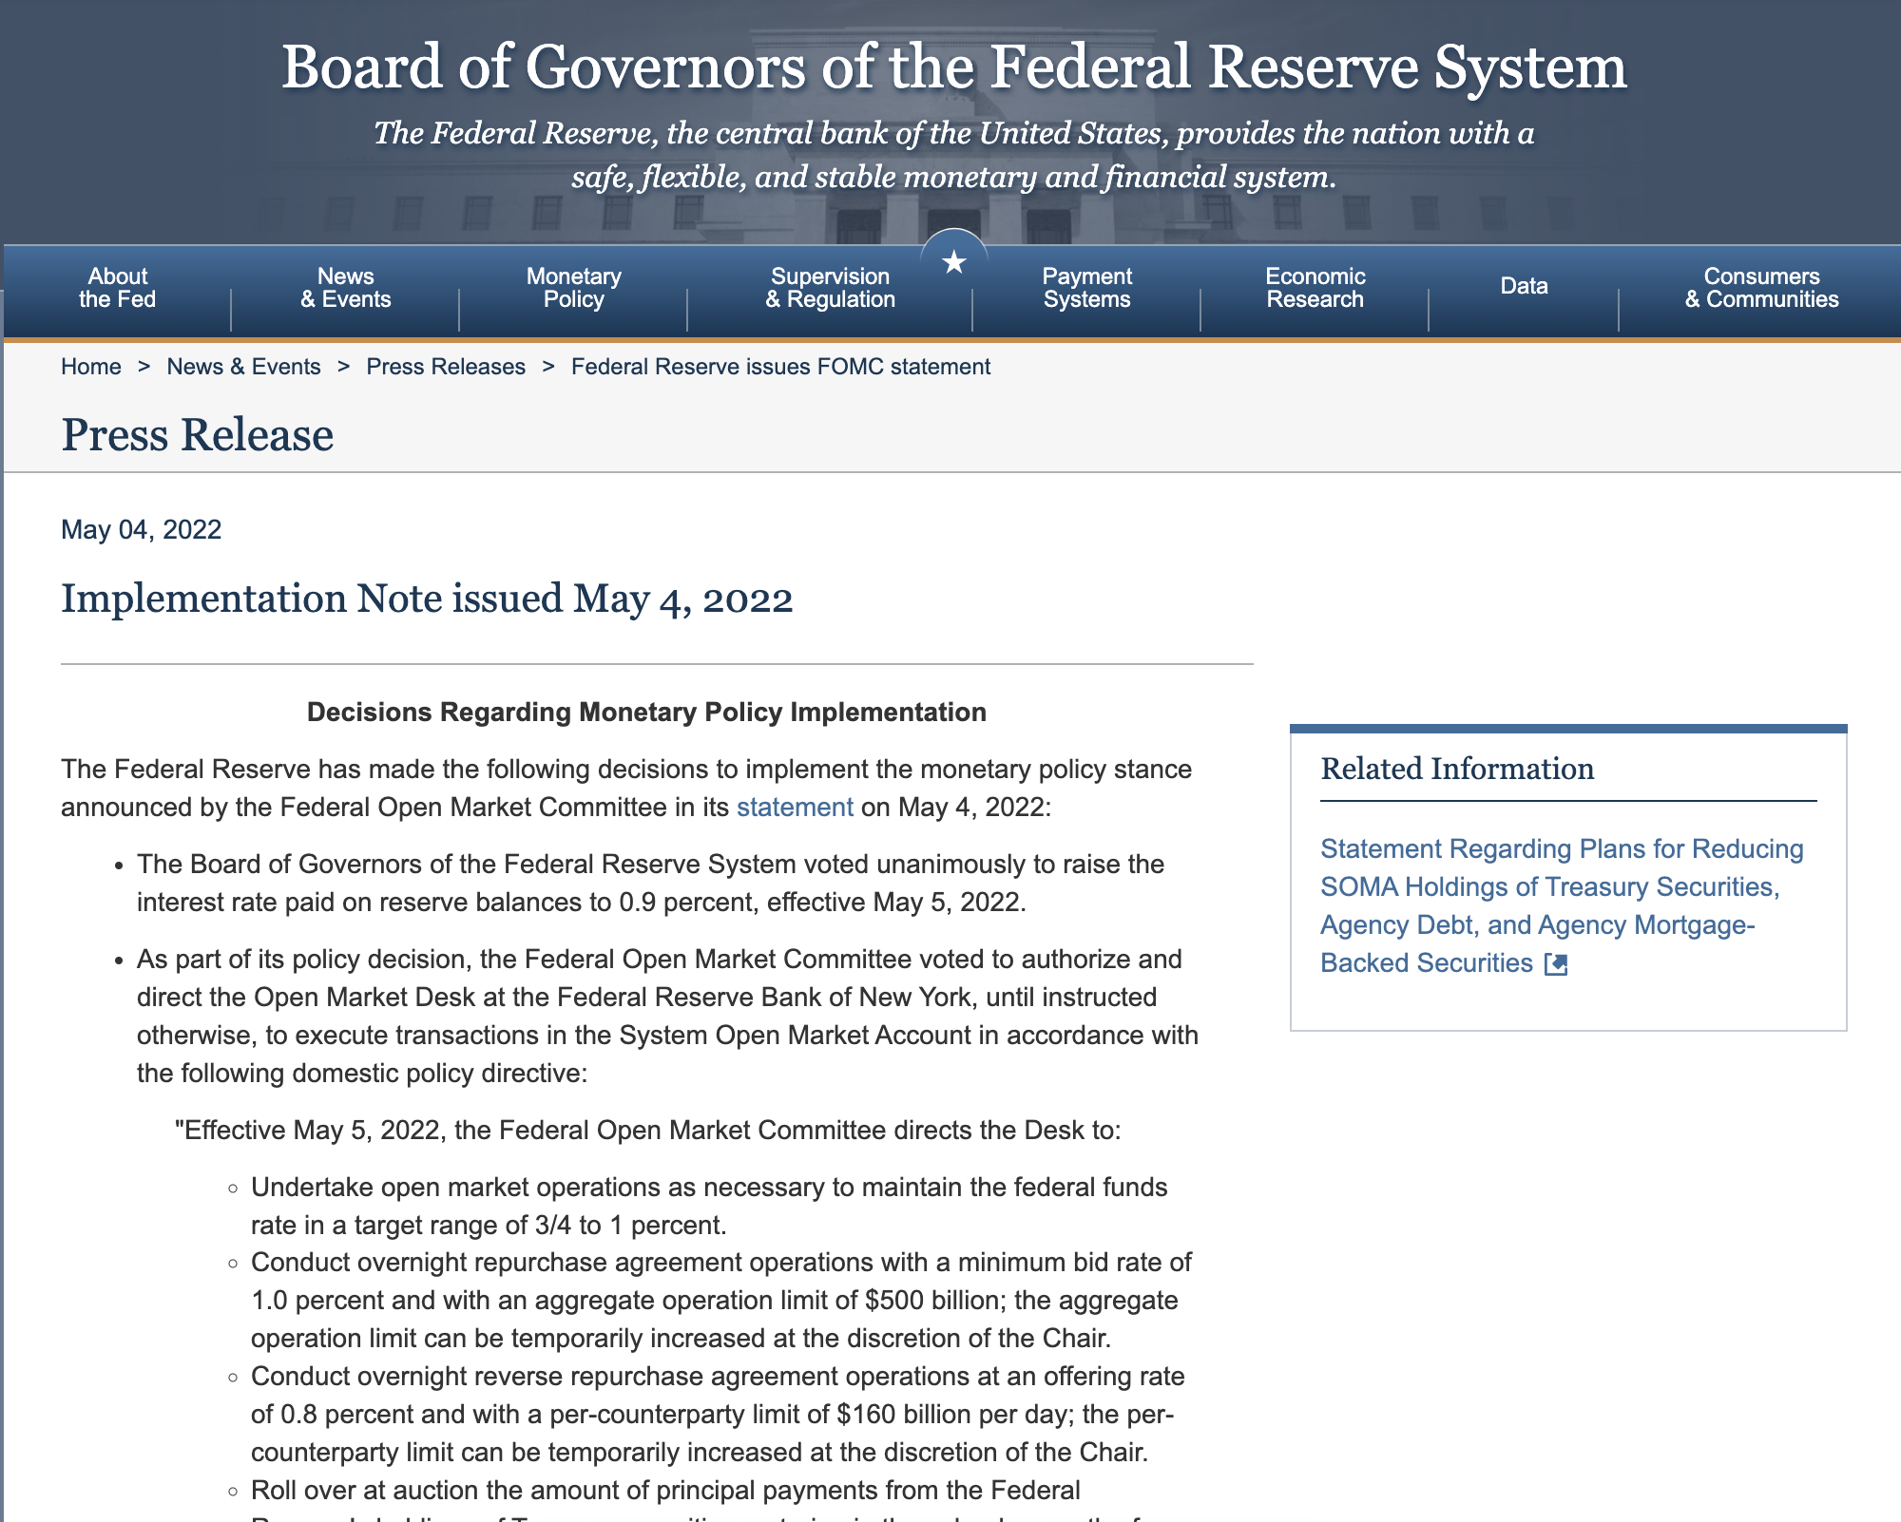
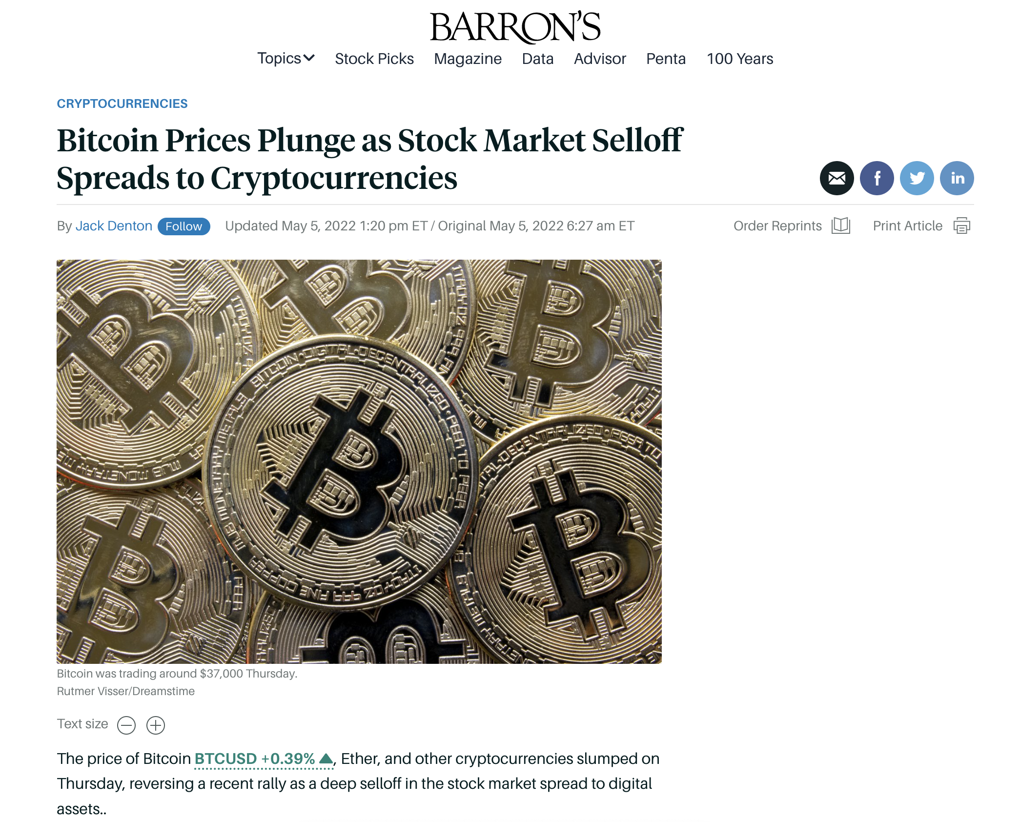
There were many exogenous reasons to withdraw. On May 4th, the Fed announced it was increasing rates which generally depressed asset prices across the board.
The original implementation note was issued May 4th for an effective rise on May 5th.
After impacting equities, the selloff continued into the cryptocurrency market suppressing prices.
Notes:
https://www.federalreserve.gov/newsevents/pressreleases/monetary20220504a1.htm
https://www.barrons.com/articles/bitcoin-ether-crypto-prices-today-federal-reserve-51651746418

Slide 19
Furthermore, Anchor, which drove 75% of all UST demand, was quickly running out of reserves. It was common knowledge that the window to collect subsidized returns was quickly closing.
Anchor was the predominant, and in the later stages only, major DeFi use case and platform for UST.
Furthermore, these returns were sustained by liquidating the yield reserve which was quickly running out.
In the final stages of the ecosystem, nearly 75% of all UST supply was deposited on Anchor. Even what limited UST borrowing demand there was seemed to be only so that a user could deposit that UST back into Anchor. Ultimately, this strongly tied Terra demand to Anchor.
Anchor’s 20% rates were unsustainable and were draining a treasury reserve. Terra was likely funding the unsustainable rate in order to grow the network quickly, however even at its current size, the treasury could only sustain the rate for another month before it required topping up or ran out of funds.
Notes:
https://defillama.com/protocol/anchor/Terra/Tokens-terrausd
https://messari.io/asset/terrausd/charts/supply
https://www.theblockcrypto.com/data/decentralized-finance/cryptocurrency-lending

Slide 20
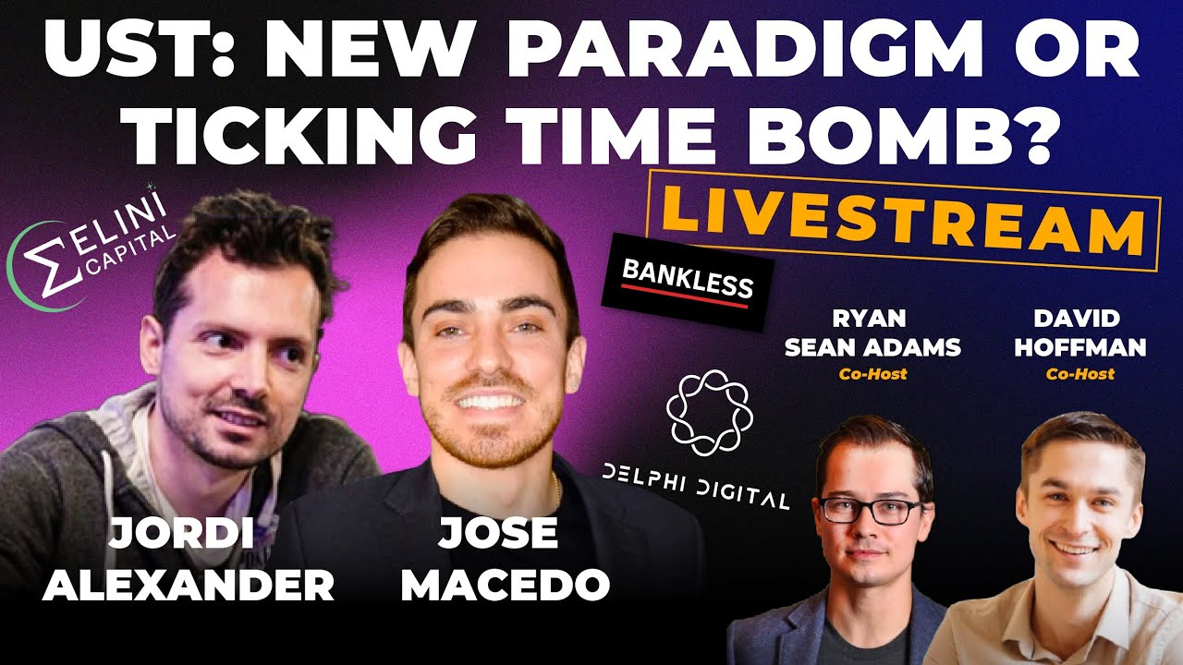
Even hedge funds that were bearish on Terra were invested in Anchor just to access the treasury reserves. Nearly all of them were likely ready to exit at the earliest sign of any sort of volatility.
Bankless - UST: New Paradigm or Ticking Time Bomb?
Key Highlights and Summary
Funds Were in Anchor:
Even bearish funds like Selini Capital were taking advantage of Anchor’s 20% protocol. They had clear information as to the size and capacity of the Anchor Yield Reserves and were sufficiently sophisticated to be able to rapidly react to any market volatility. Gaining access to the $450M+ of Yield reserve was seen as a simple straight forward strategy with manageable risks and had high capital efficiency, the exact kind of investment that is most attractive to a large well capitalized fund.
In Place Exit Strategies:
Jordi mentions a specific exit strategy which is to exit via the curve pool. For most retail investors this is a difficult process as it requires withdrawing Terra from Anchor, pushing it across the wormhole bridge to the Ethereum ecosystem, and then exchanging it on Curve.fi. Even sophisticated investors would struggle to justify the high fees on the Ethereum network unless they were moving significant amounts of capital.
Funds vs Retail:
One of the key highlights was the fact that funds, due to their sophistication and analytics, would be able to react to signals much faster than retail investors. This would allow them to easily beat investors to liquidity pools, but also requires them to be relatively more risk adverse and to quickly exit at the earliest signs of volatility.
While we don’t have insider access to these crypto hedge fund strategy, Jordi Alexander of Selini Capital provides key insights into his thoughts on Terra during a taping on April 6th, well before any market volatility even appeared possible. Specifically being in Anchor while being bearish (Jump to 0:22:50)
https://www.youtube.com/watch?v=6eOU5OaKd8s
Notes:
https://www.youtube.com/watch?v=6eOU5OaKd8s

Slide 21

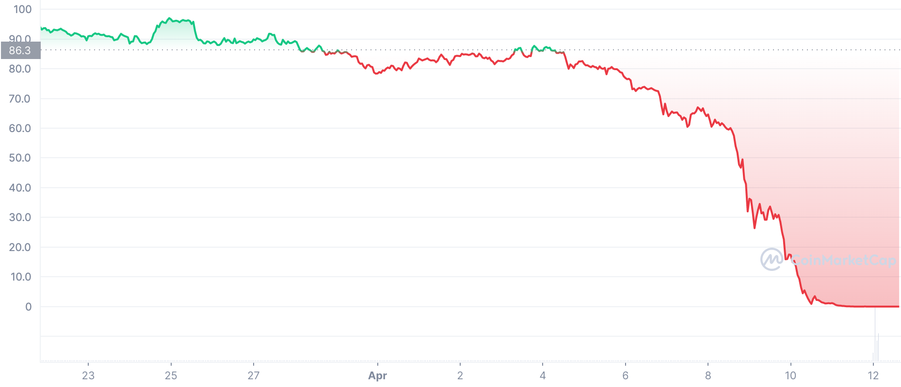
The reason these funds want to exit first, is that algorithmic multi-token stablecoins have a self-enforcing feedback loop that quickly causes a death spiral.
These models reward the first person to exit the ecosystem, creating a race to the exits at the earliest signs of instability.
Terra
Terra
When any stablecoin, such as Terra, loses the peg, risk-averse users start to exit in order to get the highest prices, and race to the exit.
If trading out on the open market, these exits drop the demand for Terra, dropping its price further. Meanwhile newly minting Luna supply drops its price at a time when its demand was already shrinking.
The dropping price now gives the next risk-tranche of users a reason to exit driving a rapid spiral that ultimately collapses the price.
This cycle rapidly repeats until the value of the currency is completely wiped out.
The reason that the price of Terra cannot maintain the peg at all times is that there is a set amount of Terra that can be redeemed for Luna per day, originally $20M, but during the crises it was $100M.
Notes:
https://www.cnet.com/personal-finance/crypto/terras-luna-crypto-crash-how-ust-broke-and-whats-next/#:~:text=Only%20%24100%20million%20worth%20of,couldn't%20retain%20its%20peg.

Slide 22
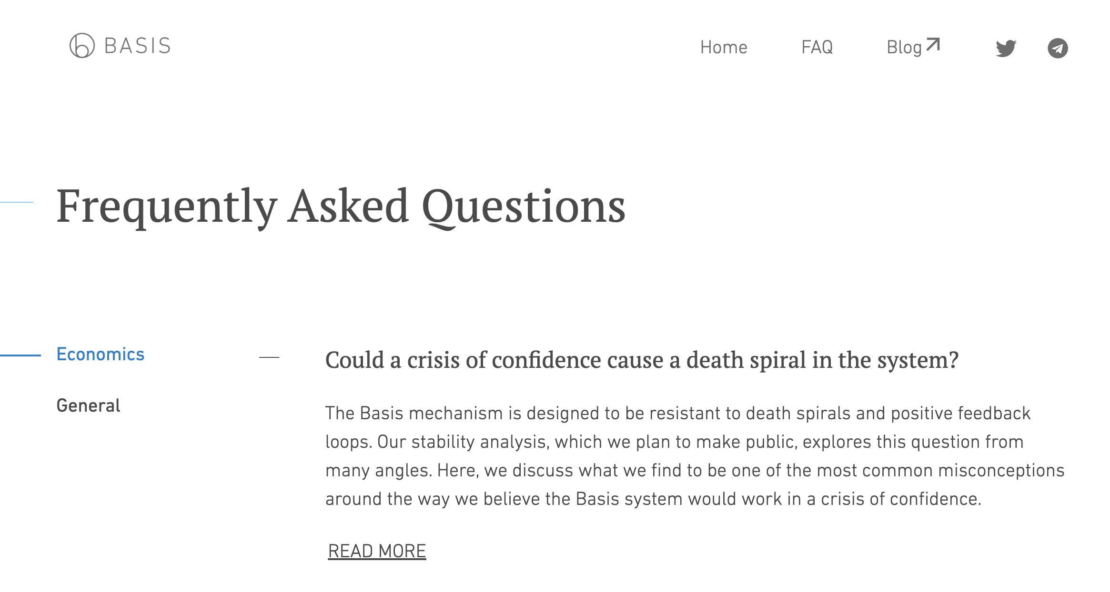
This feedback loop is well known and isn’t unique to Terra. As the price of TITAN fell, more and more users rushed to the exits rapidly collapsing the price in just 22 hours.
A death spiral stemming from a crisis of confidence is a common problem in all algorithmically managed stablecoins.
TITAN
This feedback loop has been known for decades when it comes to central banks. Even for Basis, the original algorithmically managed stable coin first envisioned in 2018, the most frequent asked question was “Could a crisis of confidence cause a death spiral in the system?” and has an entire webpage dedicated solely to the question.
https://www.basis.io/article/could-a-crisis-of-confidence-cause
Notes:
https://ironfinance.medium.com/iron-finance-post-mortem-17-june-2021-6a4e9ccf23f5
https://papers.ssrn.com/sol3/papers.cfm?abstract_id=3888752
https://www.coingecko.com/
https://www.basis.io/
https://www.basis.io/article/could-a-crisis-of-confidence-cause

Slide 23
It’s likely that large funds exited quickly at the first signs of outflow. The comparatively unsophisticated retail investors likely only recognized the signs of distress as UST broke the peg on May 9th.
No specific event seems to have triggered these outflows as the actual flows on-chain are from unrelated wallets withdrawing throughout the day at randomly distributed timings. Some wallets continued to withdraw through the 13th.
5/7/2022 – 5/9/2022
It is likely that during this time, the sophisticated funds and investors had seen outflows start at Anchor and began to deploy their own exit strategies. The rapid snowball effect of the exits across so many unassociated wallets and distributed at random time intervals, seems to indicate that these were exits based on on-chain events and data.
5/9/2022 – 5/10/2022
Traditional retail investors meanwhile would only notice the obvious signal of the initial depeg. Now that Terra had slipped the peg, it inspired a run in the more risk-adverse portion of the retail population.
5/10/2022 - Present
These exits were most likely from the least sophisticated investors or those most passionate about the Luna project. At the point that LFG reserves were depleted, there was no more hard currency or alternative assets to support the price.
Notes:
https://app.flipsidecrypto.com/velocity/queries/ffd84e80-0854-44d8-aace-2404bbdd25e9
https://app.flipsidecrypto.com/velocity/queries/106a6e5e-a4a5-4e99-b6b9-6eed226d8f00

Slide 24
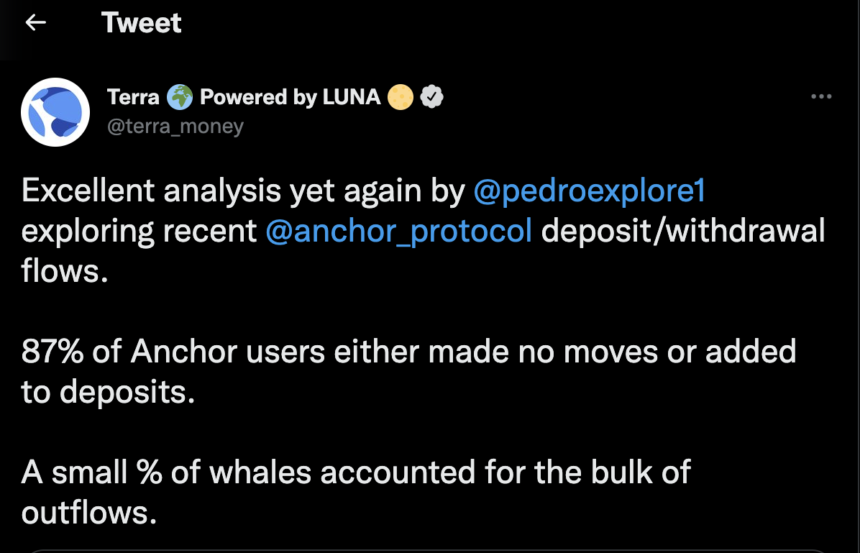
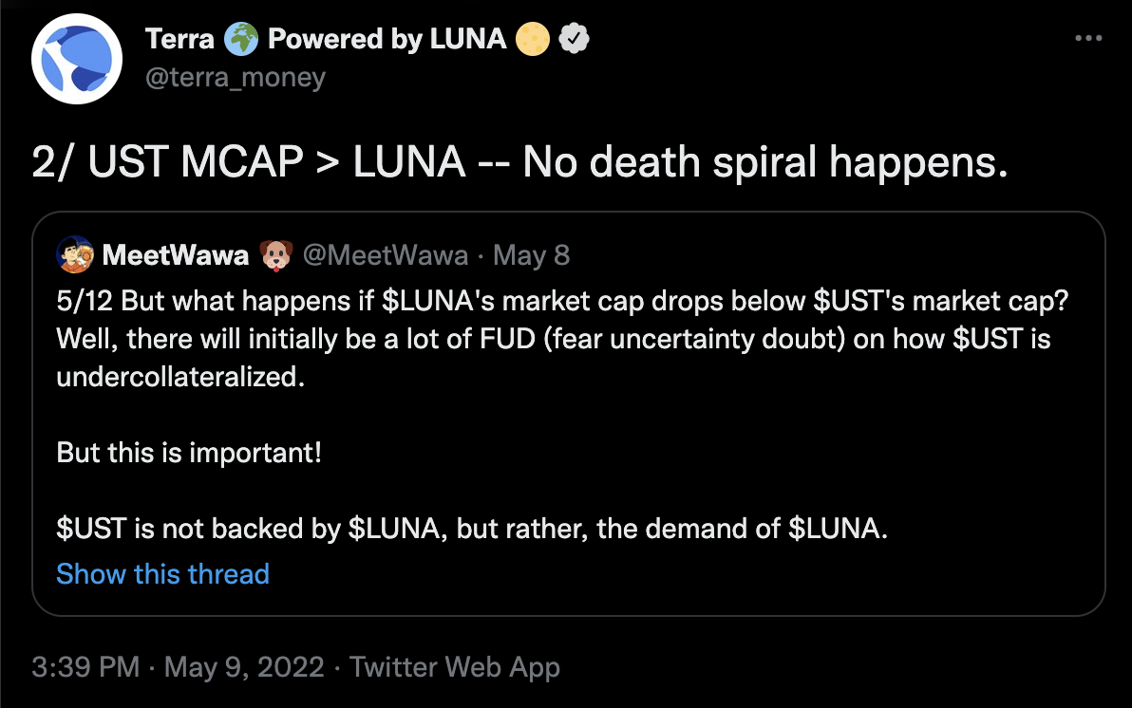
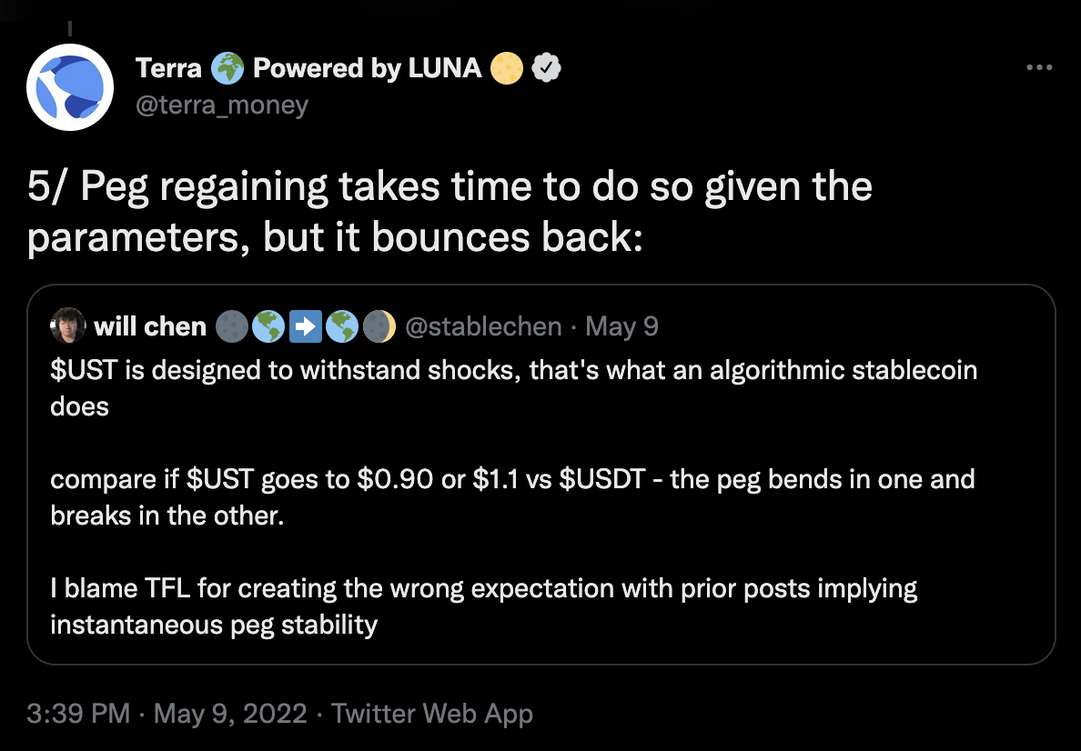
Terra’s crash had 3 discrete liquidity runs instead of a consistent, linear crash like there was for IRON. This is likely because Terra was downplaying the significance of the events throughout the crisis.
Many unsophisticated investors were likely misled by Terra’s official communications. During the initial stages of the crisis, Terra was downplaying the impact of Anchor withdrawals, its susceptibility to a run and the instability of the peg mechanism.
Impact of Withdrawals
During May 8th when Anchor was experiencing $2.7B of withdrawals, Terra was downplaying the significance of the sizable volume of outflowing capital by conflating volume of withdrawals with a proportion of all deposited wallets.
Susceptibility to a Run
Even during the initial stages of the depeg and crisis of confidence, Terra was officially tweeting that there was no death spiral despite several historical examples, empirical evidence that it was occurring to Terra, and the rapidly diverging peg necessitating the deployment of LFG reserves.
Stability of Peg Mechanism
TFL has always been nebulous about the effectiveness of their peg stability mechanism. At times, Terra has lent the impression that their peg mechanism guarantees immediate stability, and at others that it takes time to recover. Though neither are really true as the stability of the system is predicated on underlying demand for Luna.
Notes:
https://twitter.com/terra_money

Slide 25
Terra’s assessments, whether genuinely held or not, were incorrect. These withdrawals were massive and mortal. Ultimately draining all of Anchor, UST’s primary source of demand, in just a few days.
Anchor net outflows completely devastated demand and there was no alternative use for UST. As far as we’ve seen, even borrowed Terra was only ever used to deposit back into Anchor to mint more ANC reward tokens.
Anchor Daily Net Capital Flows (UST)
Notes:
https://app.anchorprotocol.com/#/

Slide 26
While the market might have been able to eventually absorb these outflows, LFG’s decision to remove liquidity from the Curve3+UST pool likely led to the the peg breaking before buyers could be found.
During this market volatility, LFG constrained liquidity in the Curve3 pool. While the pool was able to sustain outflows for 40 hours, it eventually was overwhelmed causing the initial depeg of Terra on the Ethereum network.
5/7/2022 17:00 UTC
LFG begins to drain $300M in liquidity, mostly Curve3 liquidity, out of the Curve3+UST Pool in preparation for the move to 4Pool.
Curve3+UST Liquidity
5/9/2022 9:00 UTC
Anchor outflows start to saturate the now significantly reduced liquidity of the Curve3+UST Pool. While the pool was able to sustain normal trading volumes for 40 hours, eventually demand overwhelmed the constrained liquidity causing the initial depeg of Terra.
5/9/2022 - 5/11/2022
Due to increased risks, volatility, and potential losses, liquidity providers begin to withdraw their capital further constraining the pool and destabilizing Terra.
5/11/2022 7:25 UTC
In light of the sizable impermanent losses, a single large account removes their liquidity, followed by other large accounts over the following days.
TX:0x6cb387f4a9f8701ce531f9a390745ebd97201edf49c52039d40fced8cb177fb9
5/9/2022 21:20 UTC
LFG deploys its full BTC reserves to prop up the price causing Curve3 liquidity to temporarily increase
Notes:
https://dune.com/mhonkasalo/4pool-Curve-FRAXUSTUSDCUSD
https://twitter.com/stablekwon/status/1523315720012001282
https://www.coindesk.com/business/2022/05/08/ust-briefly-loses-peg-luna-drops-10/
https://etherscan.io/tx/0x90f3f4647a33ded6e53818e3c142279547150340a2b5ffd7d0fd7eb36778f6c5 (Curve3 Liquidity withdrawal transaction 1)
https://etherscan.io/tx/0x18bd477f9beeff22b2ad0c6d48a9c0f02b542049789f0638f5ec50365f1d1de7 (Curve3 Liquidity withdrawal transaction 2)

Slide 27
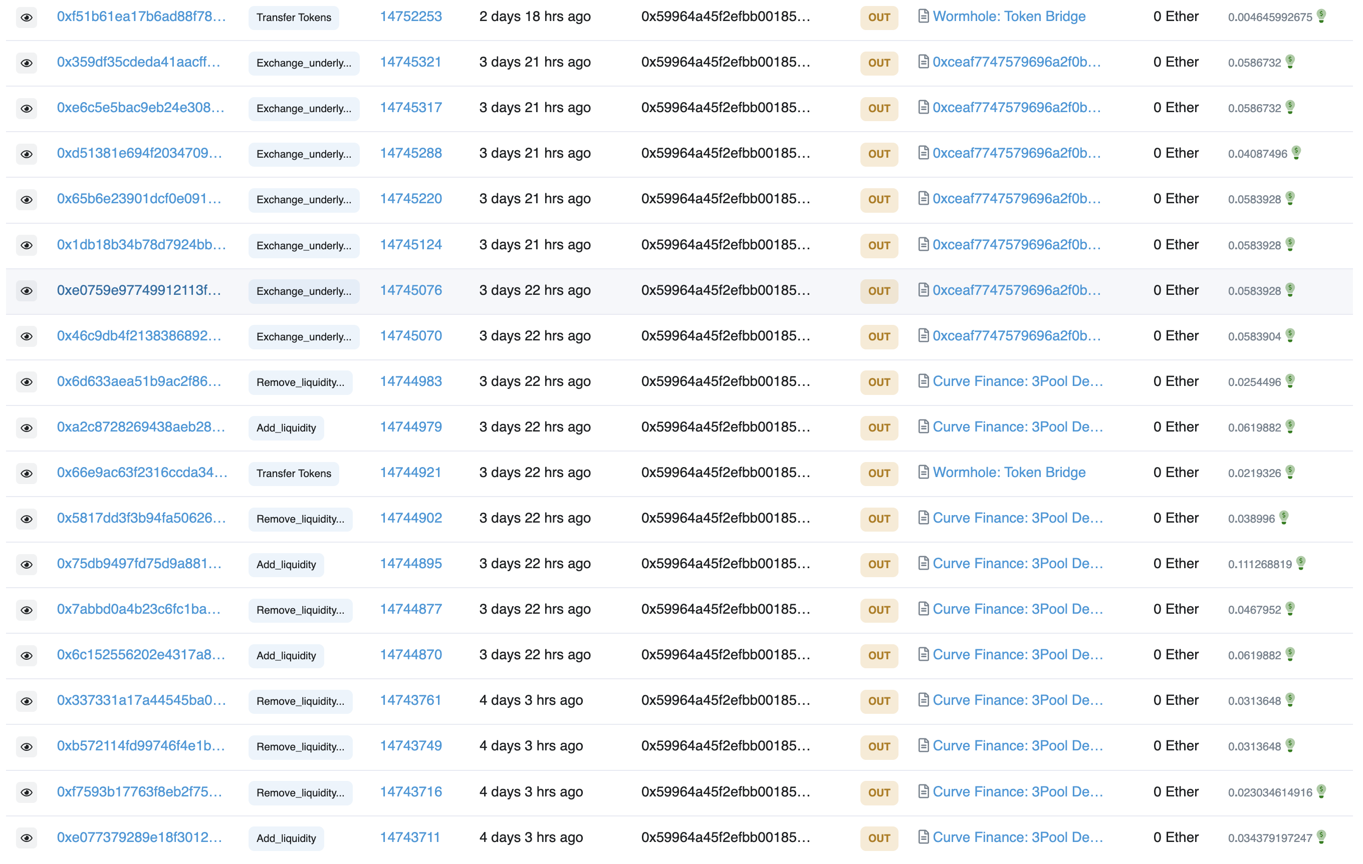
The on-chain data does not provide evidence of an attack on Curve either. From the chain data, most of the users of the Curve pool that day seemed to be consistent traders there.
Most accounts showed consistent trading activity and the one that didn’t actually moved to support the peg.
On Chain Data is Consistent
Many Users Moved to Support the Peg
DateTime | From | To | Quantity | Method
5/9/22 16:18 | 0x59964a45f2efbb001859ab57e3e4cdcfb7f3d2c0 | 0xa79828df1850e8a3a3064576f380d90aecdd3359 | 72,605,457.55 | Remove_liquidity_one_coin
5/9/22 16:18 | 0xa79828df1850e8a3a3064576f380d90aecdd3359 | 0x0000000000000000000000000000000000000000 | 72,605,457.55 | Remove_liquidity_one_coin
5/9/22 16:15 | 0x0000000000000000000000000000000000000000 | 0x59964a45f2efbb001859ab57e3e4cdcfb7f3d2c0 | 67,594,138.20 | Add_liquidity
5/8/22 14:40 | 0x0000000000000000000000000000000000000000 | 0x59964a45f2efbb001859ab57e3e4cdcfb7f3d2c0 | 59,892,383.93 | Add_liquidity
5/8/22 14:40 | 0x59964a45f2efbb001859ab57e3e4cdcfb7f3d2c0 | 0xa79828df1850e8a3a3064576f380d90aecdd3359 | 59,892,383.93 | Remove_liquidity_one_coin
5/8/22 14:40 | 0xa79828df1850e8a3a3064576f380d90aecdd3359 | 0x0000000000000000000000000000000000000000 | 59,892,383.93 | Remove_liquidity_one_coin
5/8/22 14:50 | 0x0000000000000000000000000000000000000000 | 0x59964a45f2efbb001859ab57e3e4cdcfb7f3d2c0 | 59,819,351.77 | Add_liquidity
5/8/22 14:51 | 0x59964a45f2efbb001859ab57e3e4cdcfb7f3d2c0 | 0xa79828df1850e8a3a3064576f380d90aecdd3359 | 59,819,351.77 | Remove_liquidity_one_coin
5/8/22 14:51 | 0xa79828df1850e8a3a3064576f380d90aecdd3359 | 0x0000000000000000000000000000000000000000 | 59,819,351.77 | Remove_liquidity_one_coin
5/8/22 14:59 | 0x0000000000000000000000000000000000000000 | 0x59964a45f2efbb001859ab57e3e4cdcfb7f3d2c0 | 59,769,596.09 | Add_liquidity
5/8/22 15:00 | 0x59964a45f2efbb001859ab57e3e4cdcfb7f3d2c0 | 0xa79828df1850e8a3a3064576f380d90aecdd3359 | 59,769,596.09 | Remove_liquidity_one_coin
5/8/22 15:00 | 0xa79828df1850e8a3a3064576f380d90aecdd3359 | 0x0000000000000000000000000000000000000000 | 59,769,596.09 | Remove_liquidity_one_coin
5/8/22 3:16 | 0x59964a45f2efbb001859ab57e3e4cdcfb7f3d2c0 | 0xa79828df1850e8a3a3064576f380d90aecdd3359 | 42,245,914.38 | Remove_liquidity_one_coin
5/8/22 3:16 | 0xa79828df1850e8a3a3064576f380d90aecdd3359 | 0x0000000000000000000000000000000000000000 | 42,245,914.38 | Remove_liquidity_one_coin
5/8/22 3:11 | 0x7182a1b9cf88e87b83e936d3553c91f9e7bebdd7 | 0xa79828df1850e8a3a3064576f380d90aecdd3359 | 42,051,833.99 | Remove_liquidity_one_coin
5/8/22 3:11 | 0xa79828df1850e8a3a3064576f380d90aecdd3359 | 0x0000000000000000000000000000000000000000 | 42,051,833.99 | Remove_liquidity_one_coin
5/9/22 1:31 | 0x59964a45f2efbb001859ab57e3e4cdcfb7f3d2c0 | 0xa79828df1850e8a3a3064576f380d90aecdd3359 | 39,909,196.60 | Remove_liquidity_one_coin
5/9/22 1:31 | 0xa79828df1850e8a3a3064576f380d90aecdd3359 | 0x0000000000000000000000000000000000000000 | 39,909,196.60 | Remove_liquidity_one_coin
5/8/22 3:01 | 0x0000000000000000000000000000000000000000 | 0x59964a45f2efbb001859ab57e3e4cdcfb7f3d2c0 | 22,255,391.23 | Add_liquidity
5/9/22 22:10 | 0x0000000000000000000000000000000000000000 | 0x59964a45f2efbb001859ab57e3e4cdcfb7f3d2c0 | 21,418,352.85 | Add_liquidity
5/9/22 22:11 | 0x59964a45f2efbb001859ab57e3e4cdcfb7f3d2c0 | 0xa79828df1850e8a3a3064576f380d90aecdd3359 | 21,418,352.85 | Remove_liquidity_one_coin
5/9/22 22:11 | 0xa79828df1850e8a3a3064576f380d90aecdd3359 | 0x0000000000000000000000000000000000000000 | 21,418,352.85 | Remove_liquidity_one_coin
5/9/22 17:11 | 0x0000000000000000000000000000000000000000 | 0x59964a45f2efbb001859ab57e3e4cdcfb7f3d2c0 | 20,151,521.52 | Add_liquidity
5/8/22 20:48 | 0x0000000000000000000000000000000000000000 | 0x59964a45f2efbb001859ab57e3e4cdcfb7f3d2c0 | 19,955,396.14 | Add_liquidity
The Curve 3 + UST Pool Seemed to Have Normal Activity:
The users moving large amounts of capital during May 9th were also moving similar amounts of capital in both directions in the weeks and months leading up to the initial Terra depeg. Our hypothesis is that these users simply continued business as usual, perhaps through automation, without realizing that the curve 3pool + UST had experienced a liquidity drain as LFG moved the capital to the 4pool.
The Only Anomalous User Actually Attempted to Secure the Peg:
Address 0x59964a45f2efbb001859ab57e3e4cdcfb7f3d2c0 seems to be the only anomalous address, appearing for the first time that day and trading hundreds of millions of dollars. However, they acted to support the peg by buying UST and transferring it to Terra to exchange for Luna. This user, or more likely bot, seems to just be taking advantage of the arbitrage opportunity when Terra broke the peg.
Notes:
https://etherscan.io/token/0xceaf7747579696a2f0bb206a14210e3c9e6fb269?a=0x9538d438d506fc426db37fb83dac2a0752a02757

Slide 28
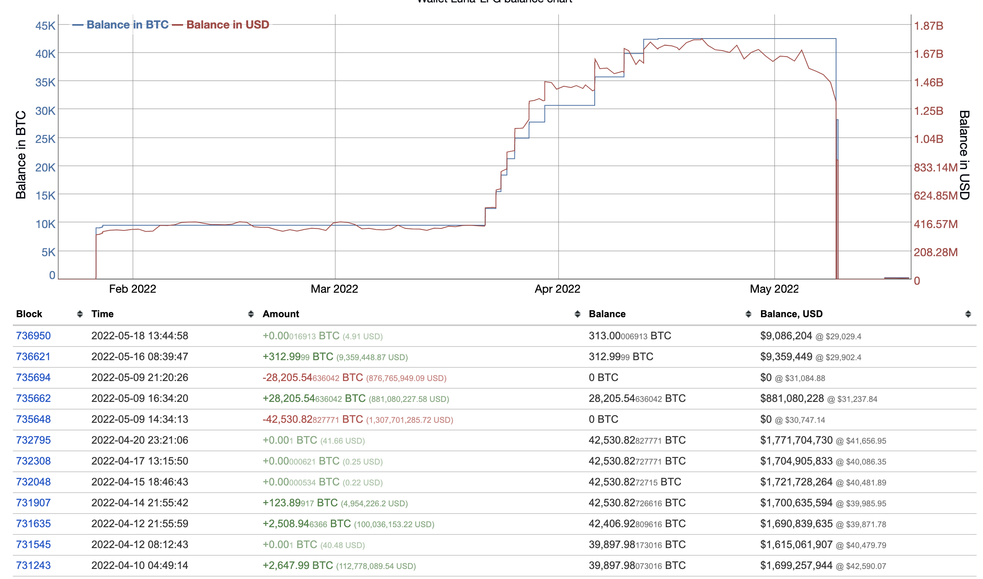
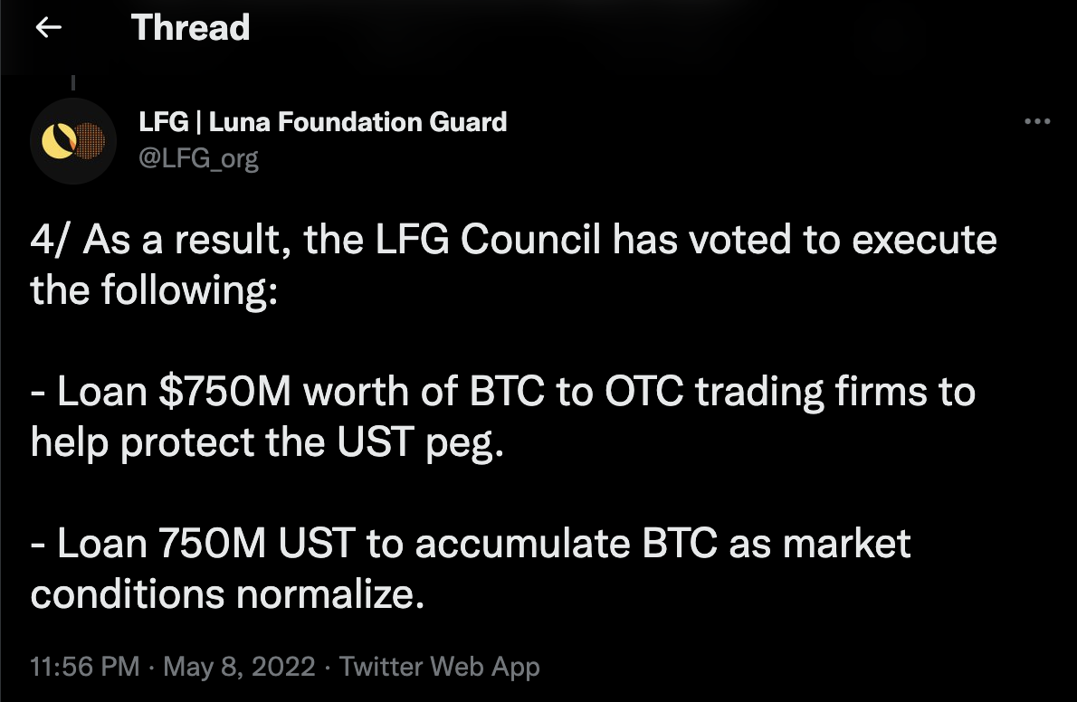
However, once Terra depegged, it was likely to enter into a terminal “death spiral”. In a vain attempt to stop the spiral, LFG “loaned” nearly all of their BTC reserves to halt the dynamic.
All BTC assets were deployed by 05/09/2022 21:20 UTC
These assets were claimed to be a “loan”
LFG deployed their entire reserve, $1.5B to manage the losses of Terra and stabilize the peg. Ultimately, these efforts were unsuccessful and did not arrest the spiraling decline in prices for Luna and Terra.
Both LFG and Do Kwon himself referred to the deployment of these assets as a “loan” in both BTC and UST. The UST, which subsequently slipped the peg was never ‘loaned’ to accumulate BTC, but the entirety of the BTC reserve was liquidated.
Notes:
https://bitinfocharts.com/bitcoin/wallet/Luna-LFG
https://twitter.com/LFG_org

Slide 29
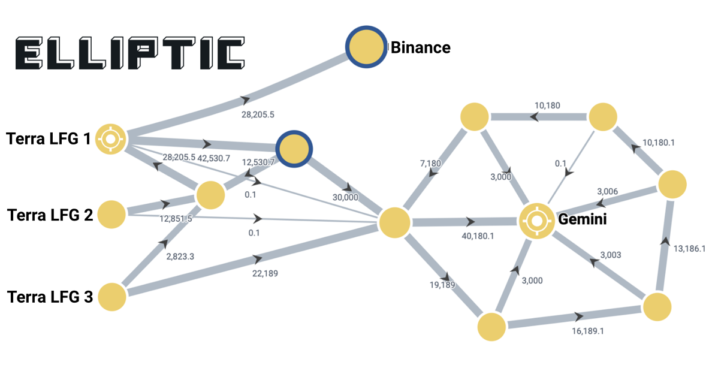
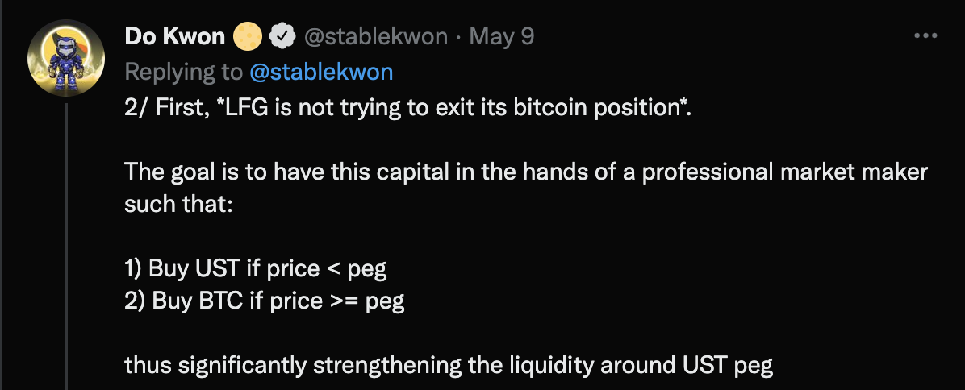
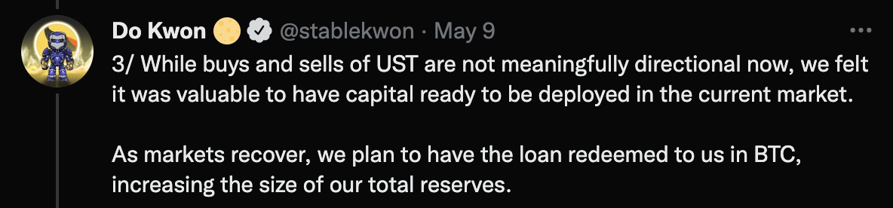
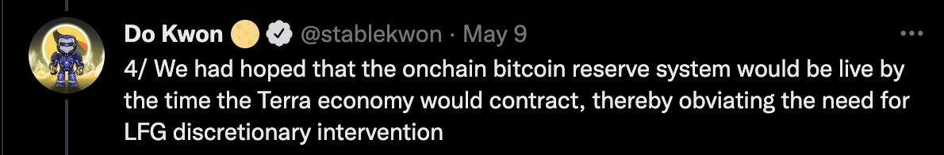
It is now known that it wasn’t a ‘loan’ at all, rather these assets were sold directly to Binance and Gemini. 28,205 BTC to the former and 52,189 BTC to the latter.
Do Kwon in a latter tweet provided the details of the “loan”
These BTC ultimately were sold to major exchanges
As is evident now, this wasn’t really a “loan” but rather a liquidation. All of the BTC tokens were sold to Gemini and Binance in order to arrest the falling prices of Terra and Luna. Ultimately to no avail, as the nearly $20B in UST could not be guaranteed by the $1.5B in BTC deployed by LFG.
Notes:
https://jackofalltechs.com/2022/05/15/onchain-analysis-report-says-terras-bitcoin-reserves-were-sent-to-binance-and-gemini/
https://twitter.com/stablekwon

Slide 30
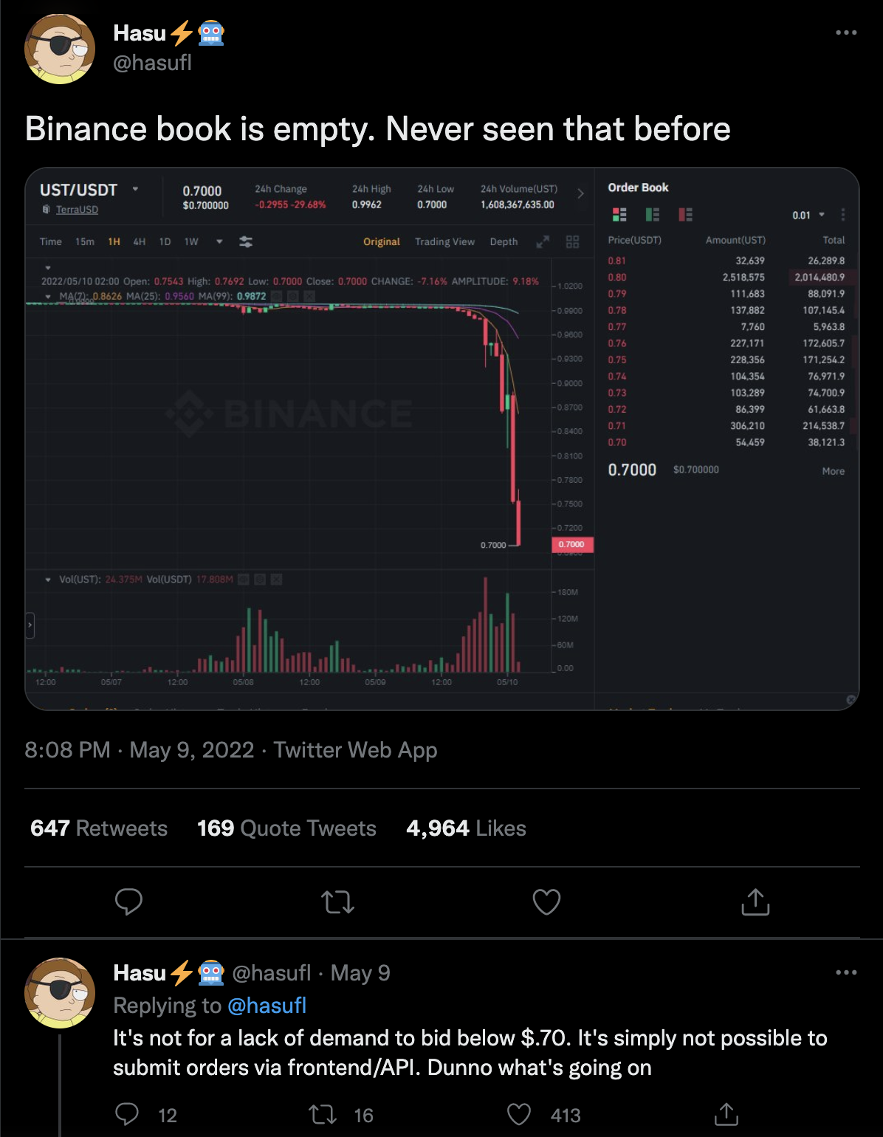
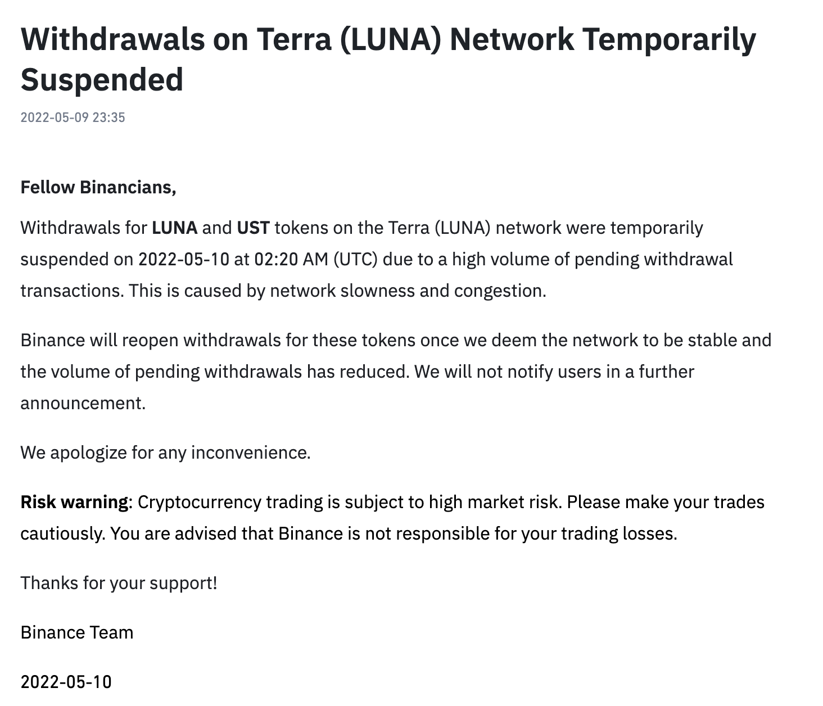
Shortly after receiving the BTC, Binance unilaterally halted trading on its exchange below $0.70 for Terra and suspended any withdrawals at 2:20 UTC on May 10th.
Several users were reporting that Binance simply wouldn’t accept any orders either selling or buying UST under 0.70.
Binance furthermore officially suspended all withdrawals “due to high volume of pending transactions”
Notes:
https://www.binance.com/en/support/announcement/dc02bedd65be40f7b10022f26bc06879
https://twitter.com/hasufl/status/1523817151471230976
https://www.cnet.com/personal-finance/crypto/terras-luna-crypto-crash-how-ust-broke-and-whats-next/#:~:text=Only%20%24100%20million%20worth%20of,couldn't%20retain%20its%20peg.

Slide 31
However these actions did little to stem the depeg for more than a few hours. The price of Luna continued its collapse as a result of the run and Terra quickly followed to around 10 cents.
The price of Luna had completely collapsed 64 hours after the initial depeg with UST hovering around 10 cents.
Notes:
https://www.federalreserve.gov/newsevents/pressreleases/monetary20220504a1.htm
https://dune.com/mhonkasalo/4pool-Curve-FRAXUSTUSDCUSDT
https://bitinfocharts.com/bitcoin/wallet/Luna-LFG
https://coinmarketcap.com/currencies/terrausd/

Slide 32
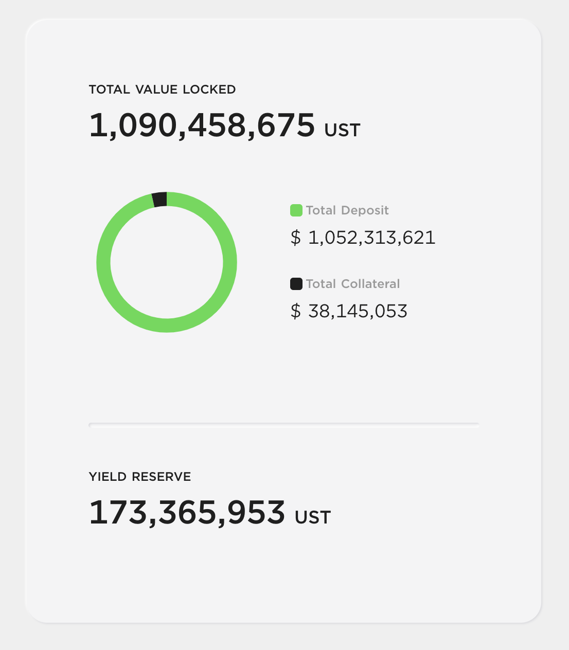
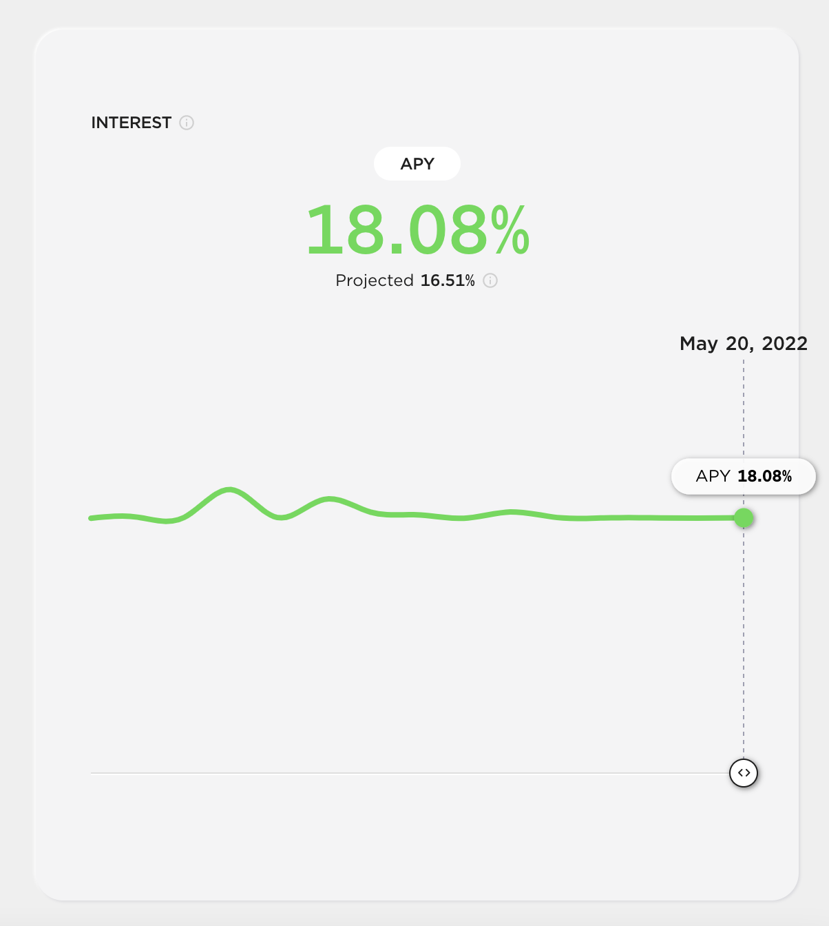
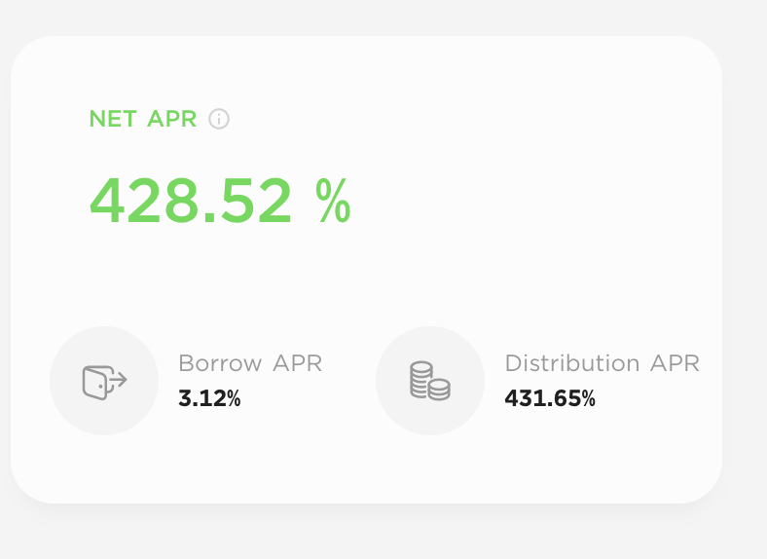
The price of Terra hasn’t completely collapsed as 1B+ UST tokens are still in Anchor, generating interest from the yield reserve even though there is no borrowing demand.
The price of Luna had completely collapsed 64 hours after the initial depeg with UST hovering around 10 cents.
Deposit APR
Anchor Yield Reserves Still Available:
As the yield reserves are still available, Anchor can continue to pay out 18%+ interest on UST deposits creating some demand. As of May 20th, 1B+ Tokens are still deposited.
Virtually No Borrow Demand:
Due to the collapse of the prices of Luna and Terra, there is virtually no borrowing demand. The only remaining collateral on the platform is $35M of bETH which might just be forgotten capital. As of the collapse of UST there is virtually no borrow demand, and interest received on collateral is over 400%.
ANC Token Price Also Collapsed:
The value of ANC tokens has also collapsed. As of writing it is hovering around 10 cents similar to UST.
Collateral APR
Notes:
https://app.anchorprotocol.com/

Slide 33



The second order effects of the collapse of Terra, a $60B+ ecosystem was very limited. As of writing, there haven’t been any notable financial contagion to other asset classes or projects.
Terra Was Too New and Limited.
Terra had only been around for less than year at any meaningful volume before it imploded While its growth to $60B in just 12 months is a tower achievement, the speed of its growth didn’t allow for many third party connections or for dependencies to built on the ecosystem.
As a case in point, Terra does not have a vibrant NFT ecosystem, there aren’t any major ERC-20 token equivalents on the Terra blockchain, and its only major cross chain connection is the wormhole bridge to Ethereum. As a good example of a well connected project, ThorChain also built on Cosmos, serves as a bridge between several large layer 1 projects.
Killer Apps Were Internal Projects
Third party developers were extremely rare on the Terra ecosystem. The overwhelming value of the network was the first party apps Anchor and the ecosystems tight integration with UST. Over the course of the life of the project, notable attempts were made to included third parties including vendors, payment platforms, Dapps and other projects however none were successful.
Ultimately, Terraform Labs built the network, UST, Anchor and Mirror, all of the major use cases of the ecosystem. At one point, 75% of all UST was on Anchor, and there weren’t any real uses for the borrowed UST other than investing it straight back into Anchor. This limited the fallout to Terraform Labs.
Failure Modes Were Well Known
It is well known that most multi-coin algorithmic stablecoin projects struggle to reduce token supply, especially at the speed at which demand curves can change. Multiple individuals had identified the flaws of this model with just a cursory glance at Terra’s stability mechanism and limited their exposure.
If not for the $500M+ yield reserve, it is unlikely that any fund would have even decided to pursue any exposure of Luna or UST at all. Those that did, such as Selini Capital, likely had sophisticated contingency plans for this eventually limiting the fall out.

Slide 34
The limited outcomes as of writing are the two traditional impacts of any financial crash; a “bank run” on stable assets and an enduring constrained liquidity environment.
In the wake of the Terra collapse there was a run on Tether’s deposits reducing overall supply by $9B.
Curve Pools have seen tightened liquidity in the days after the collapse of Terra. (Measured here in ETH tokens)
5/11/2022
Total Collapse of Luna’s Price
5/11/2022
Total Collapse of Luna’s Price
One of the most classic results of a financial crash is a run on the banks. Since the Great Depression, the FDIC and other regulators in all countries have stepped in to assure the solvency of banks during crises. In crypto, we saw the equivalent run through a drain on Tether’s supply.
As is typical, users pull their liquidity out of the market during periods of expected high volatility in order to minimize risks to themselves. As crypto assets lack traditional credit exposure risk, this mostly means reducing the exposure to liquidity pools to avoid risks of impermanent loss.
Notes:
https://defillama.com/protocol/curve/all/ETH
https://messari.io/asset/tether/historical

Slide 35
STARDUST
For any questions, please reach out to us at:
Theresa Garcia (Theresa@stardustfunds.com)
Adit Patel (adit.patel@stardustfunds.com)

